Slide 1



A Mobile Traffic Predictor Enhanced by Neighboring Transportation Data (MTP-NT)
Programa de Pós-Graduação em Ciência da Computação
Candidato: Patrick Luiz de Araújo
Orientador: Rafael Pasquini
Coorientador: Murillo Guimarães Carneiro
Defesa de dissertação de mestrado em 21/11/2023
Notes:
00:24

Slide 2
Contents
Introduction
Related Work
Theoretical fundamentation
Preliminaries on data collection for MTP-NT
MTP-NT: Framework structure and fundamentation
Experimental results
Final considerations and future work
Notes:
00:48

Slide 3
Data per month, per smartphone in 2028
Introduction
5 billion
5G subscribers in 2028
19 GB/month
100 exabytes
Data per quarter in 2028
Fonte: Ericsson Mobility Report, November 2022
Notes:
De acordo com o Ericsson Mobility Report de Novembro de 2022

Slide 4
Introduction
To
New 5G networks will count on
Allocate the maximum amount of users
Core Network (CN) based on Virtual Network Functions (VNF) over a Network Function Virtualization (NFV)² topology
Use Machine Learning (ML) and other predictive tools
Optimize network operability
Reach 5G QoS/QoE metrics¹
1ms latency
low energy consumption
High coverage
Intelligent caching in network edge
Cloud computing optimization
[1] AGIWAL, M.; ROY, A.; SAXENA, N. Next generation 5g wireless networks: A comprehensive survey. IEEE Communications Surveys Tutorials, v. 18, n. 3, p. 1617–1655, 2016.
[2] Sun, Y. et al. Application of machine learning in wireless networks: Key techniques and open issues. IEEE Communications Surveys Tutorials, v. 21, n. 4, p. 3072–3108, 2019.
Notes:
[01:36]
Dentre as várias características modernas do 5G, destacamos:
NFV: topologia usando cloud e/ou edge
Estruturas com a capacidade que necessitam, economizando recursos
Vai passar a ter gerenciamento de rede unificado
IA e Cloud Optimization são os principais tópicos deste trabalho

Slide 5
Introduction
AI models advantages
Rely on historical data¹²³
Can be less complex than conventional approaches⁴
Robust patterns and best overall performance⁵
[1] Wang, X. et al. Spatio-temporal analysis and prediction of cellular traffic in metropolis. In: 2017 IEEE 25th International Conference on Network Protocols (ICNP). [S.l.: s.n.], 2017. p. 1–10
[2] Wang, J. et al. Spatiotemporal modeling and prediction in cellular networks: A big data enabled deep learning approach. In: IEEE INFOCOM 2017 - IEEE Conference on Computer Communications. [S.l.: s.n.], 2017. p. 1–9.
[3] CHEN, X. et al. Analyzing and modeling spatio-temporal dependence of cellular traffic at city scale. In: 2015 IEEE International Conference on Communications (ICC). [S.l.: s.n.], 2015. p. 3585–3591.
[4] SUN, H. et al. Learning to optimize: Training deep neural networks for wireless resource management. In: 2017 IEEE 18th International Workshop on Signal Processing Advances in Wireless Communications (SPAWC). [S.l.: s.n.], 2017. p. 1–6.
[5] Sun, Y. et al. Application of machine learning in wireless networks: Key techniques and open issues. IEEE Communications Surveys Tutorials, v. 21, n. 4, p. 3072–3108, 2019.
Notes:
[02:00]
Modelos de IA
Dependem de dados históricos
Menos complexos: implementação de um alocador de potência menos complexo que o Weighted Minimum Mean-Square Error (WMMSE)

Slide 6
Introduction
Mobile Traffic Predictor Enhanced by Neighboring Transportation Data (MTP-NT)
Is a
Machine Learning model
That
Helps the scheduler to better optimize the computational and/or radio resources
By
Providing a reliable network traffic prediction
Notes:
[02:00]

Slide 7
tl;dr
Enough Data
Innovation
Compatible responsiveness
Performance
Notes:
[02:24]
Estes são os desafios a atentar-se em uma implementação de ML em 5G

Slide 8
Mobile Traffic Predictor Enhanced by Neighboring Transportation Data MTP-NT
City of Milan Dataset¹
Network usage
Geolocalized tweets
Weather
Electricity
News
[1] Barlacchi, G. et al. A multi-source dataset of urban life in the city of milan and the province of trentino. Sci Data 2, 2015.
Notes:
[02:48]
Dados
GDPR: politica de dados robusta
Dados de 1/nov/2013 até 31/dez/2013

Slide 9
Mobile Traffic Predictor Enhanced by Neighboring Transportation Data MTP-NT
City of Milan Dataset¹
Scalable public transport and neighboring data
Open source
Network usage
Geolocalized tweets
Weather
Electricity
News
[1] Barlacchi, G. et al. A multi-source dataset of urban life in the city of milan and the province of trentino. Sci Data 2, 2015.
Notes:
[03:12]
Inovação
Uso pioneiro de dados de transporte público
Dados e modelagem abertas na licença CC 4.0
Uso de feature selection para diminuir o custo computacional de treinamento e inferência do modelo

Slide 10
Mobile Traffic Predictor Enhanced by Neighboring Transportation Data MTP-NT
City of Milan Dataset¹
Scalable public transport and neighboring data
Open source
Lightweight, adaptable and highly performant
Network usage
Geolocalized tweets
Weather
Electricity
News
[1] Barlacchi, G. et al. A multi-source dataset of urban life in the city of milan and the province of trentino. Sci Data 2, 2015.
Notes:
[03:36]
Leve
Escalável através do volume de dados ingeridos
Vários volumes validados

Slide 11
Mobile Traffic Predictor Enhanced by Neighboring Transportation Data MTP-NT
City of Milan Dataset¹
Scalable public transport and neighboring data
Open source
Lightweight, adaptable and highly performant
State-of-art performance
Network usage
Geolocalized tweets
Weather
Electricity
News
[1] Barlacchi, G. et al. A multi-source dataset of urban life in the city of milan and the province of trentino. Sci Data 2, 2015.
Notes:
[04:00]
Performático
Performance
Validação por diferentes meios
Diferentes regiões da cidade e grupos de testes
Manipulação da base para avaliar outros cenários

Slide 12
Contents
Introduction
Related Work
Introduction
Network traffic characterization
Network traffic prediction
Theoretical fundamentation
Preliminaries on data collection for MTP-NT
MTP-NT: Framework structure and fundamentation
Experimental results
Final considerations and future work
Notes:
[04:24]

Slide 13
Metrics and mathematical characteristics of network usage
Related work
Characterization
Prediction
Mathematical models to predict network traffic

Slide 14
Regions of the city grouped based on network usage patterns¹ Composition of trimodal distributions to describe the network traffic² Sand temporal distribution of the network traffic results into extremely insufficient utilization of network resources² Traffic was concentrated in some regions (city center) and peak hours³
Network Traffic Characterization
[1] Xu, F. et al. Understanding mobile traffic patterns of large scale cellular towers in urban environment. IEEE/ACM Transactions on Networking, v. 25, n. 2, p. 1147–1161, 2017.
[2] WANG, H. et al. Characterizing the spatio-temporal inhomogeneity of mobile traffic in large-scale cellular data networks. In: Proceedings of the 7th International Workshop on Hot Topics in Planet-Scale MObile Computing and
Online Social NeTworking. New York, NY, USA: Association for Computing
Machinery, 2015. (HOTPOST ’15), p. 19–24. ISBN 9781450335171. Disponível em: <https://doi.org/10.1145/2757513.2757518>.
[3] Gotzner, U.; Rathgeber, R. Spatial traffic distribution in cellular networks. In: VTC
’98. 48th IEEE Vehicular Technology Conference. Pathway to Global Wireless
Revolution (Cat. No.98CH36151). [S.l.: s.n.], 1998. v. 3, p. 1994–1998 vol.3.

Slide 15
Grouping of regions based on network usage patterns
Characterization – Xu
Characteristics of traffic: temporal and frequency
Residential
Transport
Office
Entertainment
Comprehensive areas
Human labelling of some regions to generalization
Notes:
[05:36]

Slide 16
Weekday-Weekend Traffic Amount Ratio: ratio of weekdays and weekend traffic Peak-Valley Features: ratio of maximum and minimum traffic registered as seen in the figure ahead Time of Traffic Peak and Valley: time of the day of maximum and minimum network usage Discrete Fourier Transform (DFT)
Characterization – Xu
Notes:
O artigo apresenta algumas das features usadas
Weekday-Weekend Traffic Amount Ratio: quão do tráfego está concentrado em dias úteis ou não
Peak-Valley Featres: discrepância do tráfego em momentos de pico e vale. Em regiões de transporte apresentou 133.33

Slide 17
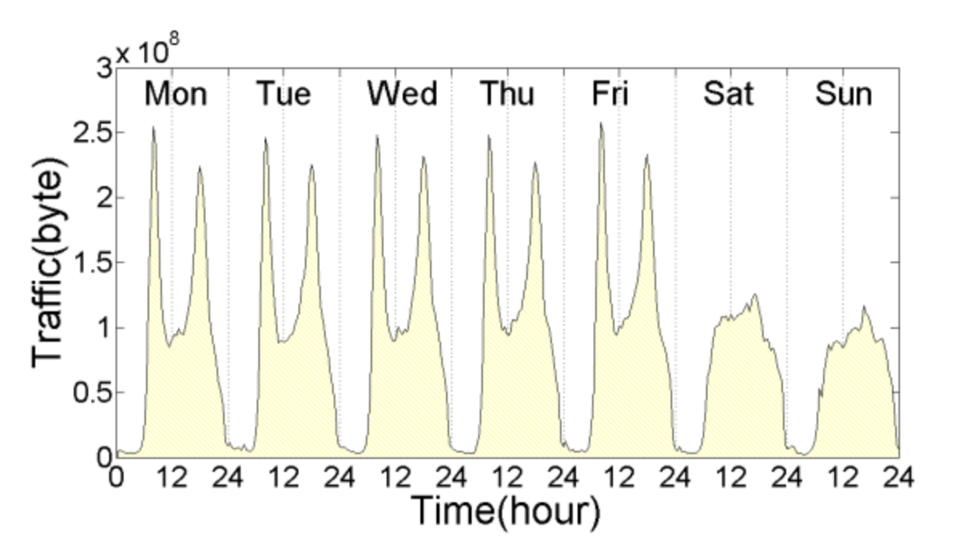
Characterization – Xu
Source: Xu, F. et al. Understanding mobile traffic patterns of large scale cellular towers in urban environment. IEEE/ACM Transactions on Networking, v. 25, n. 2, p. 1147–1161, 2017.
Notes:
Caracterização de uma região de transporte

Slide 18
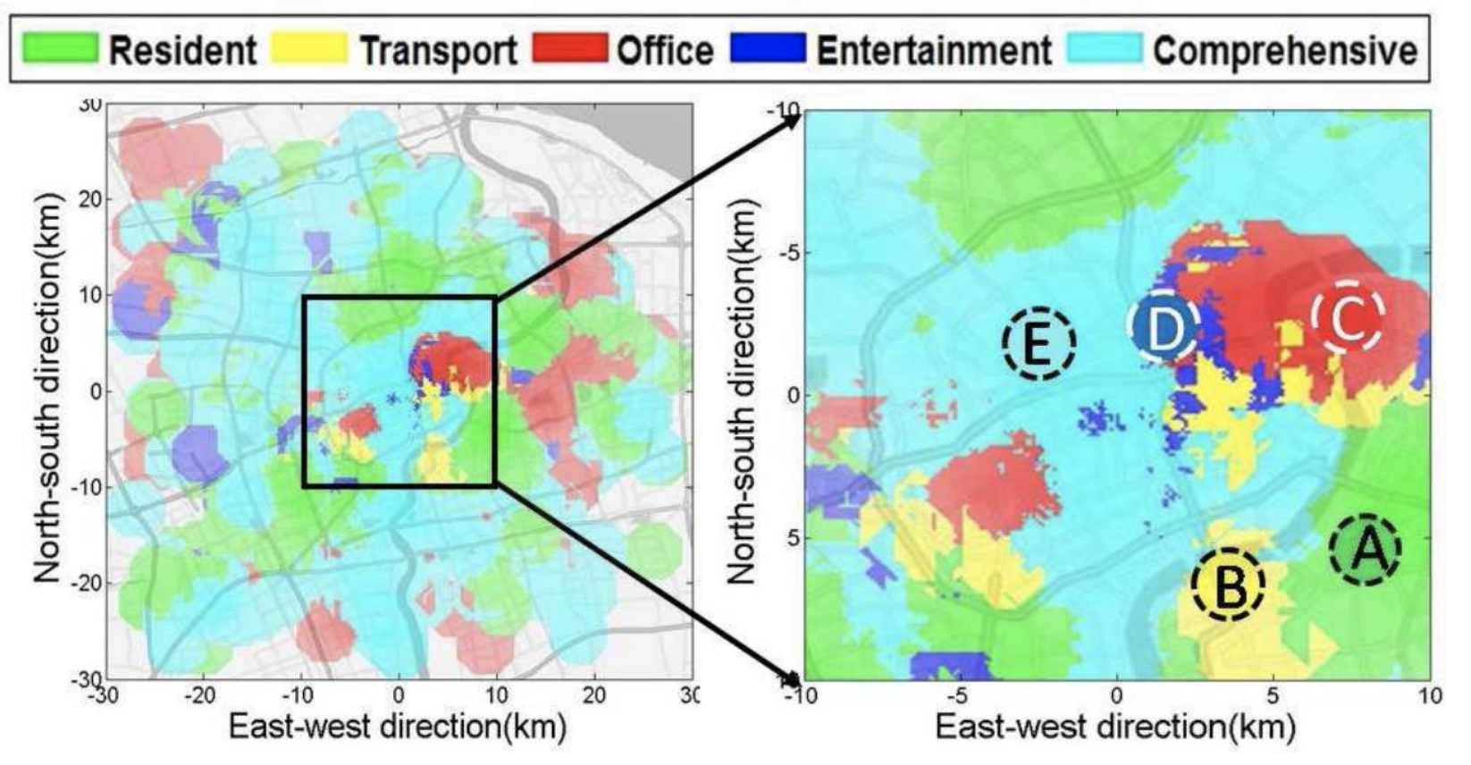
Characterization – Xu
Source: Xu, F. et al. Understanding mobile traffic patterns of large scale cellular towers in urban environment. IEEE/ACM Transactions on Networking, v. 25, n. 2, p. 1147–1161, 2017.

Slide 19
380,000 Base Stations (BSs) in Shanghai August 1 – August 31, 2014 10 minute samples of each Base Station (BS) 1.96 billion entries; 28PB (92TB per day, 7GB per BS on average)
Characterization – Wang 2015
Source: WANG, H. et al. Characterizing the spatio-temporal inhomogeneity of mobile traffic in large-scale cellular data networks. In: Proceedings of the 7th International Workshop on Hot Topics in Planet-Scale MObile Computing and Online Social NeTworking. New York, NY, USA: Association for Computing Machinery, 2015. (HOTPOST ’15), p. 19–24. ISBN 9781450335171. Disponível em: <https://doi.org/10.1145/2757513.2757518>.
Notes:
[07:12]
As amostras tiveram a mesma frequência da base usada no trabalho
Conseguiu descrever o consumo de rede por meio de uma distribuição trimodla com r-squared de 99%

Slide 20
Findings Trimodal distribution
Characterization – Wang 2015
Compound-expontential
Power-law distribution
Exponential distribution
R-square of 99%

Slide 21
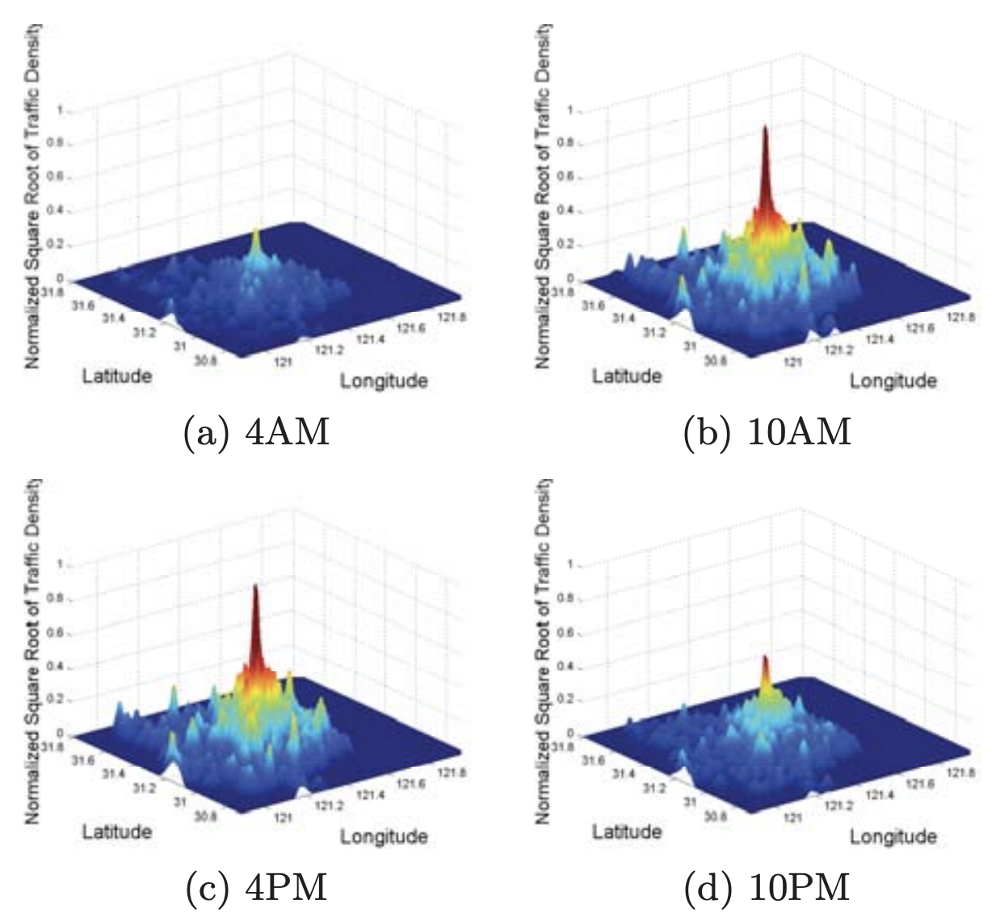
Findings Spatial and temporal distribution of network traffic highly concentrated
Characterization – Wang 2015
Source: WANG, H. et al. Characterizing the spatio-temporal inhomogeneity of mobile traffic in large-scale cellular data networks. In: Proceedings of the 7th International Workshop on Hot Topics in Planet-Scale MObile Computing and Online Social NeTworking. New York, NY, USA: Association for Computing Machinery, 2015. (HOTPOST ’15), p. 19–24. ISBN 9781450335171. Disponível em: <https://doi.org/10.1145/2757513.2757518>.
Notes:
A falta de homogeneidade causa um uso insuficiente da infraestrutura de rede

Slide 22
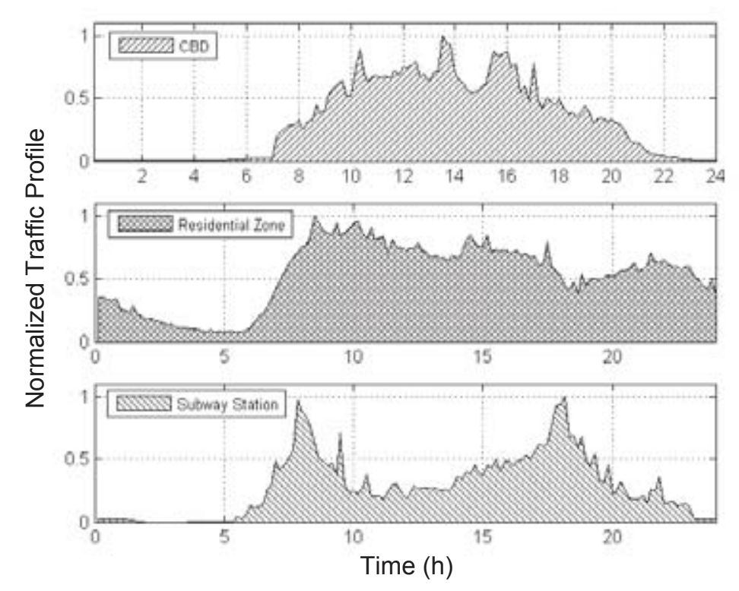
Findings Irregular usage depending on the urban ecology
Characterization – Wang 2015
Source: WANG, H. et al. Characterizing the spatio-temporal inhomogeneity of mobile traffic in large-scale cellular data networks. In: Proceedings of the 7th International Workshop on Hot Topics in Planet-Scale MObile Computing and Online Social NeTworking. New York, NY, USA: Association for Computing Machinery, 2015. (HOTPOST ’15), p. 19–24. ISBN 9781450335171. Disponível em: <https://doi.org/10.1145/2757513.2757518>.
Notes:
Reforçando a ideia da ecologia urbana

Slide 23
Network traffic in Berlin May 1996 – August 1997 Findings
Characterization – Gotzner
Traffic concentrated in city centre
Congestions in peak hours
Network resources not fully used in other points
The infrastructure reaches the maximum capacity before all processing power request
Source: Gotzner, U.; Rathgeber, R. Spatial traffic distribution in cellular networks. In: VTC’98. 48th IEEE Vehicular Technology Conference. Pathway to Global Wireless Revolution (Cat. No.98CH36151). [S.l.: s.n.], 1998. v. 3, p. 1994–1998 vol.3.
Notes:
[08:48]
A infraestrutura chega ao seu limite de atendimento antes de ser integralmente ocupada

Slide 24
Network Traffic Prediction
Pure Time Series Function (TSF) and Non-TSF problem¹
1989
1991
2017
2021
AutoRegressive Moving Average (ARIMA) and Neural Network model training with Simulated Annealing (SA)⁷
In-tower and inter-tower traffic analysis through a Graph Neural Network (GNN)⁶
Recurrent Neural Network and usage of global + local autoencoders⁵
[1] BOUTABA, R. et al. A comprehensive survey on machine learning for networking: evolution, applications and research opportunities. Journal of Internet Services and Applications, Springer, v. 9, n. 1, p. 1–99, 2018.
[2] CYBENKO, G. Approximation by superpositions of a sigmoidal function. Mathematics of control, signals and systems, Springer, v. 2, n. 4, p. 303–314, 1989.[3] Funahashi, 1989
[4] HORNIK, K. Approximation capabilities of multilayer feedforward networks. Neural networks, Elsevier, v. 4, n. 2, p. 251–257, 1991.[5] Wang, 2017a
[5] FUNAHASHI, K.-I. On the approximate realization of continuous mappings by neural networks. Neural networks, Elsevier, v. 2, n. 3, p. 183–192, 1989.
[6] Wang, X. et al. Spatio-temporal analysis and prediction of cellular traffic in metropolis. In: 2017 IEEE 25th International Conference on Network Protocols (ICNP). [S.l.: s.n.], 2017. p. 1–10.
[7] YANG, H. et al. A network traffic forecasting method based on sa optimized arima–bp neural network. Computer Networks, v. 193, p. 108102, 2021. ISSN 1389-1286. Disponível em: <https://www.sciencedirect.com/science/article/pii/ S1389128621001821>.
MLP to network traffic forecasting⁴
Single Layer Perceptron (SLP) to traffic perdiction³
Multi Layer Perceptrion (MLP) to traffic perdiction²

Slide 25
2844 Base Stations (BSs) in Suzhou 500m² Uses the neighborhood concept LSTM Cells paired with Global and Local Autoencoders
Prediction – Wang 2017a
Source: Wang, J. et al. Spatiotemporal modeling and prediction in cellular networks: A big data enabled deep learning approach. In: IEEE INFOCOM 2017 - IEEE Conference on Computer Communications. [S.l.: s.n.], 2017. p .1–9.
Notes:
[09:36]

Slide 26
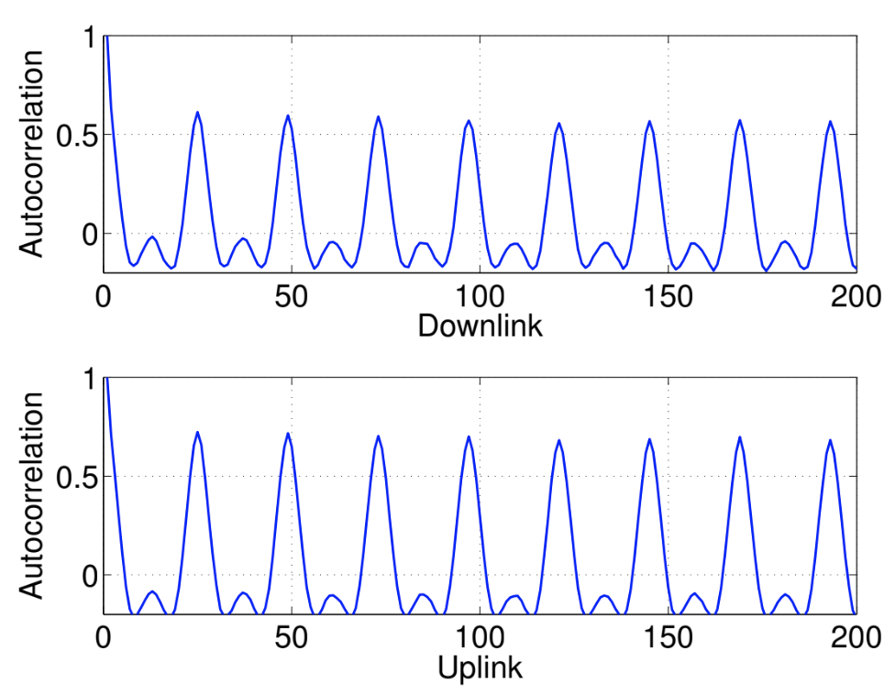
Prediction – Wang 2017a
Source: Wang, J. et al. Spatiotemporal modeling and prediction in cellular networks: A big data enabled deep learning approach. In: IEEE INFOCOM 2017 - IEEE Conference on Computer Communications. [S.l.: s.n.], 2017. p. 1–9.
Notes:
Auto correlação do downlink e do uplink usando a Auto Correlation Function (ACF)
Picos de autocorrelação em múltiplos de 24h

Slide 27
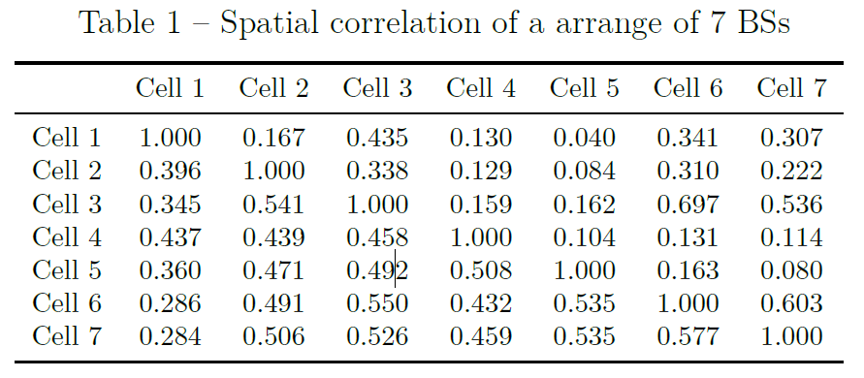
Prediction – Wang 2017a
Source: Wang, J. et al. Spatiotemporal modeling and prediction in cellular networks: A big data enabled deep learning approach. In: IEEE INFOCOM 2017 - IEEE Conference on Computer Communications. [S.l.: s.n.], 2017. p. 1–9.
Notes:
Correlação espacial
Cada torre estava subsequentemente a leste da anterior
Parte superior: uplink; Parte inferior: downlink

Slide 28
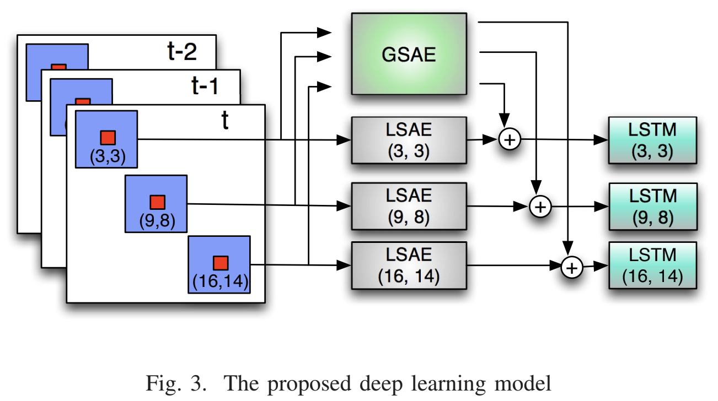
Prediction – Wang 2017a
Source: Wang, J. et al. Spatiotemporal modeling and prediction in cellular networks: A big data enabled deep learning approach. In: IEEE INFOCOM 2017 - IEEE Conference on Computer Communications. [S.l.: s.n.], 2017. p. 1–9.
Notes:
O modelo possui um arranjo de autoencoders locais bem como um autoencoder global
O autoencoder global é treinado com base nos autoencoders locais
Os arranjos são somados (append) e inseridos em redes temporais (LSTMs)

Slide 29
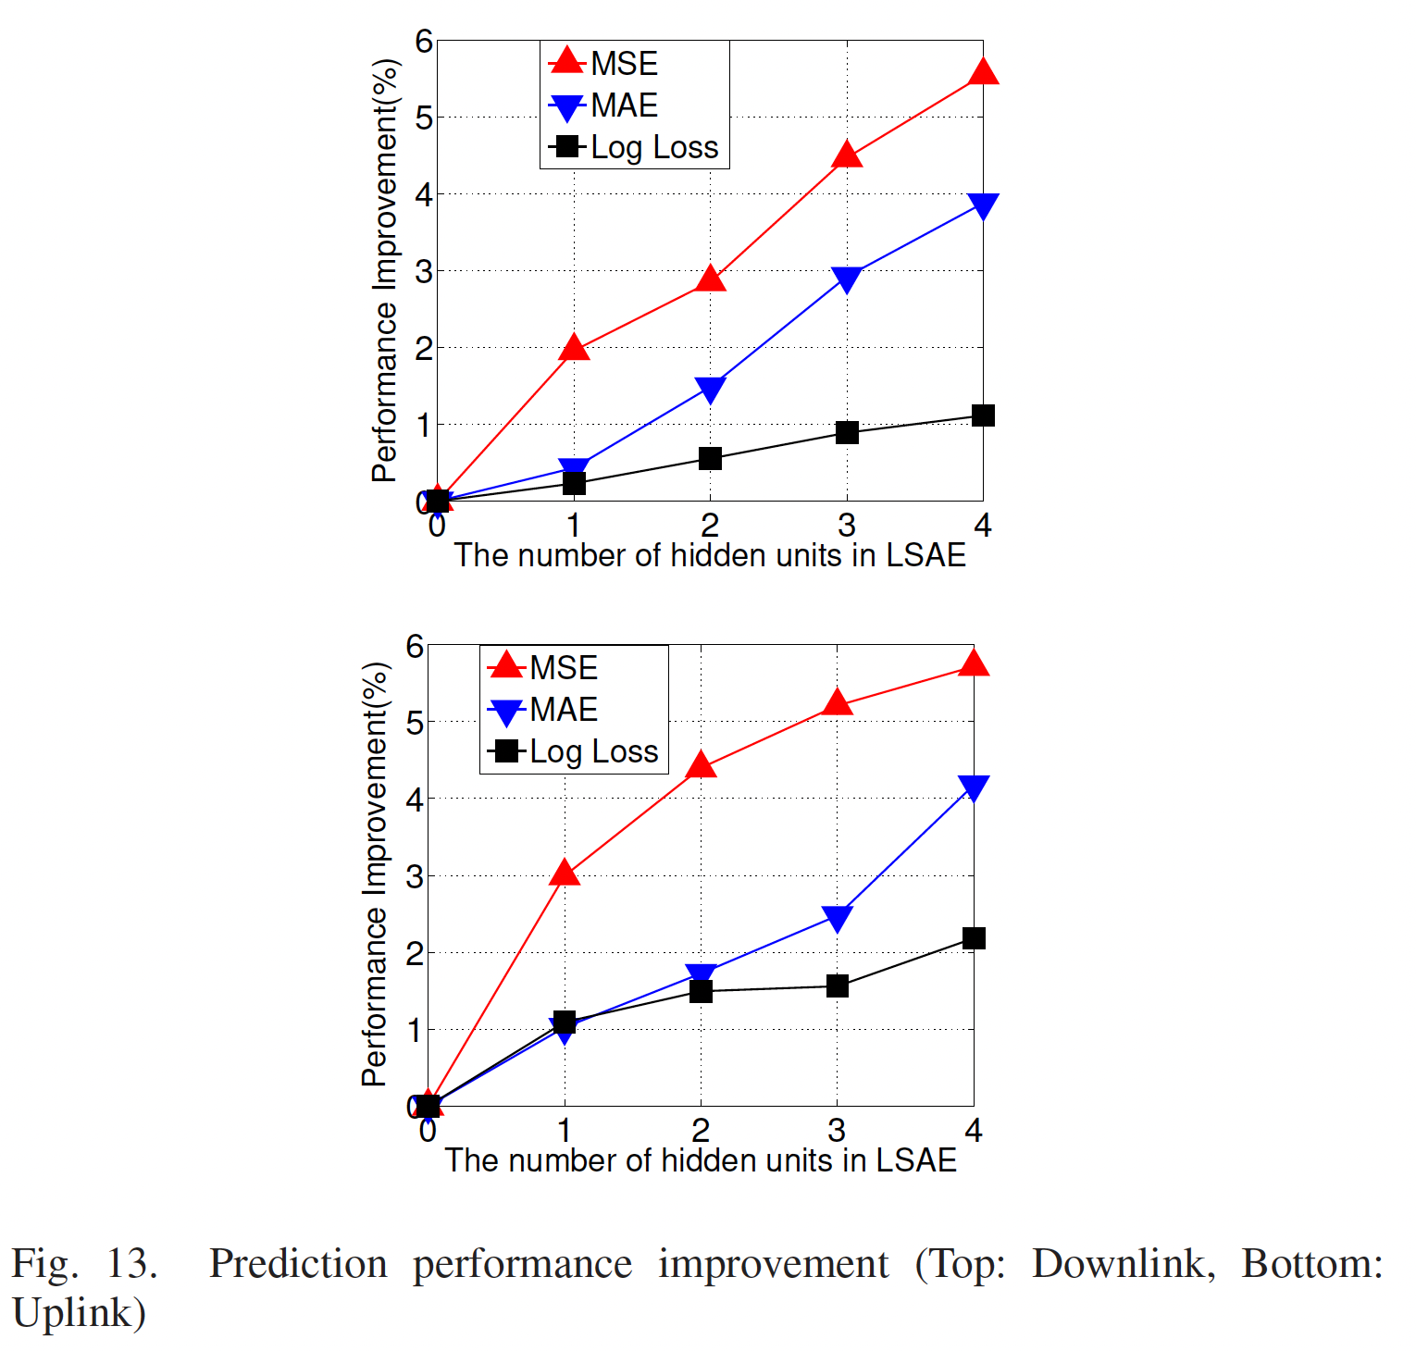
Prediction – Wang 2017a
Source: Wang, J. et al. Spatiotemporal modeling and prediction in cellular networks: A big data enabled deep learning approach. In: IEEE INFOCOM 2017 - IEEE Conference on Computer Communications. [S.l.: s.n.], 2017. p. 1–9.
Notes:
Uma comparação da performance em comparação ao número de unidades do LSAE foi feita
Uma comparação paralela foi feita no trabalho desenvolvido

Slide 30
5929 Base Stations (BSs), 1.5 million users In-tower and inter-tower traffic
Related work – Wang 2017b
Source: Wang, X. et al. Spatio-temporal analysis and prediction of cellular traffic in metropolis. In: 2017 IEEE 25th International Conference on Network Protocols (ICNP). [S.l.: s.n.], 2017. p. 1–10.
Notes:
[11:36]
Correlações causadas por modais de transporte cada vez mais eficientes

Slide 31
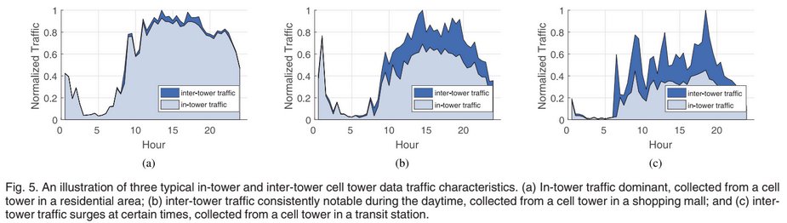
Related work – Wang 2017b
Source: Wang, X. et al. Spatio-temporal analysis and prediction of cellular traffic in metropolis. In: 2017 IEEE 25th International Conference on Network Protocols (ICNP). [S.l.: s.n.], 2017. p. 1–10.
Notes:
Conforme visto, regiões de transporte apresentam tráfego com alta mobilidade

Slide 32
Temporal correlations between physically distant towers Graph Neural Network (GNN) architecture
Related work – Wang 2017b
Source: Wang, X. et al. Spatio-temporal analysis and prediction of cellular traffic in metropolis. In: 2017 IEEE 25th International Conference on Network Protocols (ICNP). [S.l.: s.n.], 2017. p. 1–10.
Notes:
Correlações causadas por modais de transporte cada vez mais eficientes

Slide 33
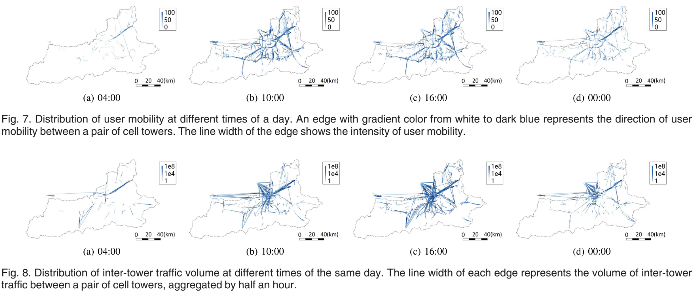
Related work – Wang 2017b
Source: Wang, X. et al. Spatio-temporal analysis and prediction of cellular traffic in metropolis. In: 2017 IEEE 25th International Conference on Network Protocols (ICNP). [S.l.: s.n.], 2017. p. 1–10.
Notes:
Correlações causadas por modais de transporte cada vez mais eficientes

Slide 34
Related work – Summary
Ref. | Method | Dataset availability | Source code available
(Wang et al., 2017a) | Autoencoders | X | X
(Wang et al., 2017b) | Graph Neural Networks | X | X
(Sciancalepore et al., 2017) | Holt Winters | No information | X
(ALAWE et al., 2018) | Deep Learning | X | X
(YANG et al., 2021) | ARIMA and Neural Network | ✓ | X
Notes:
[13:12]
Fazendo um copilado dos principais métodos e disponibilidade de dados e código fonte
Cada um considera métodos de modelagem diferentes

Slide 35
Related work – Summary
Ref. | LSTM | Time series | Grid arrange | Neighborhood concept | Spatial modelling | Residual/aperiodic events | Network traffic consumption characterization
Wang et al., 2015 |  |  |  |  |  |  | ✓
Wang et al., 2017a | ✓ |  | ✓ | ✓ | ✓
Wang et al., 2017b |  | ✓ |  | ✓ | ✓ | ✓
YANG et al., 2021 |  | ✓
Gotzner; Rathgeber, 1998 |  |  |  |  |  |  | ✓
BOUTABA et al., 2018 |  |  |  |  |  |  | ✓
Notes:
Amarrando com as principais técnicas do nosso trabalho
Importante frisar que os dados não são disponíveis publicamente, bem como os códigos fontes para validação em outros cenários

Slide 36



Related work – Summary
Dataset
Barlacchi, G. et al. A multi-source dataset of urban life in the city of milan and the province of trentino. SciData 2, 2015.
Source code
https://github.com/PatrickLdA/milan-telecom-analysis
Notes:
Amarrando com as principais técnicas do nosso trabalho
Importante frisar que os dados não são disponíveis publicamente, bem como os códigos fontes para validação em outros cenários

Slide 37
Contents
Introduction
Related Work
Theoretical fundamentation
Introduction
Neural networks development and training
LSTM
Feature selection
Preliminaries on data collection for MTP-NT
Framework structure and fundamentation
Experimental results
Final considerations and future work
Notes:
[14:00]

Slide 38
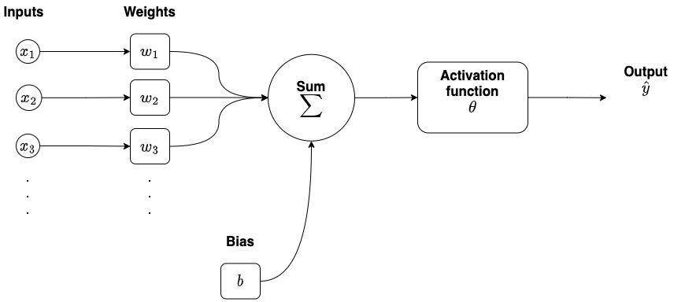

Theoretical fundamentation – Neural networks development and training
$$Z=X×W+b$$
$$\hat{Y}=θ(Z)$$
Common activation functions:
Sigmoid: output between 0 and 1;
Hyperbolic tangent: output -1 and 1;
Rectified Linear Unit (ReLU)
Source: the author
Notes:
[14:24]
Treinar uma rede neural = adaptar os pesos para minimizar o erro e=|y – y^|
Backpropagation: uma forma de treinar a rede neural; amarra o erro a variação dos pesos

Slide 39
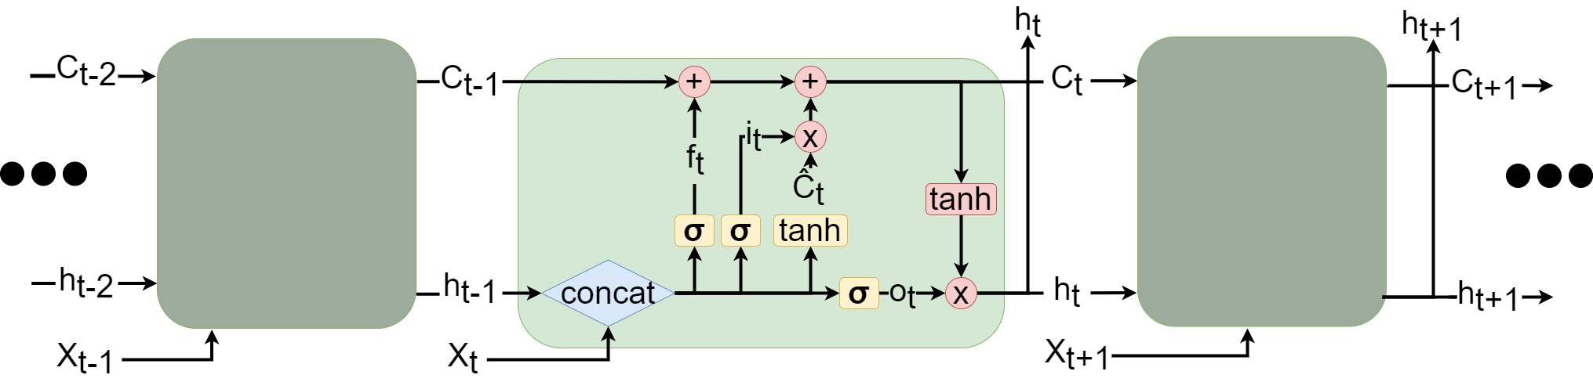
Theoretical fundamentation – LSTM
Source: the author
Notes:
[14:48]

Slide 40
Mainly used to dimensionality reduction Pearson correlation coefficient
Theoretical fundamentation – Feature selection
Between -1 and 1
Strength of the relationship between two variables
f-value Distance based algorithm
All transport regions inside 20 Moore distance*
*Later explained
Notes:
[15:12]
A redução da dimensionalidade visa minimizar a perda de performance retirando as características menos relacionadas ao alvo
Menos custos computacionais
Menos ruído
Feature seletion
Pearson: o quão duas variáveis são relacionadas
F-test: quão da variação de uma variável dependente pode ser explicada pela variação de uma outra variável
Moore: todos os hubs de transporte em uma distância de moore máxima de 20 unidades

Slide 41
Contents
Introduction
Related Work
Theoretical fundamentation
Preliminaries on data collection for MTP-NT
Preliminaries
The predictive model in the 5G infrastructure
Data Flow
Dataset used in this work
Mathematical formalization of dataset preprocessing
Framework structure and fundamentation
Experimental results
Final considerations and future work
Notes:
[15:36]

Slide 42
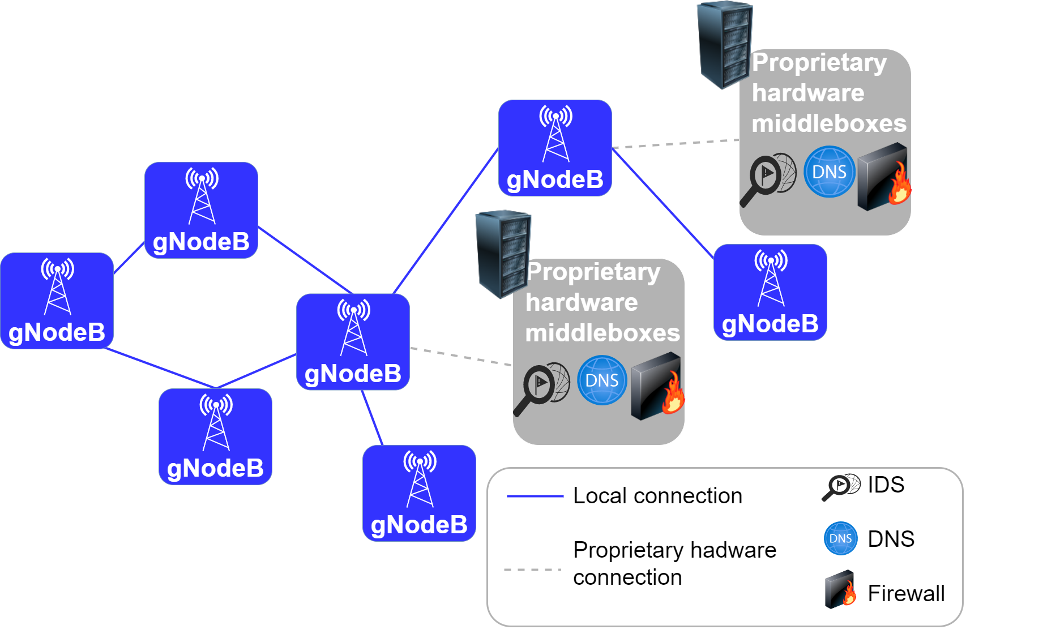
Preliminaries on data Collection for MTP-NT – The predictive model in the 5G Infrastructure
Source: the author
Notes:
[16:00]
Serviços baseados em hardware proprietário, tais como:
IDS
Proxy
Criptografia
Monitoramento de rede
Desvantagens
Ciclo de aquisição -> treinamento -> deploy custosos e rápidos
Sistema estático
Não escalável
Dependente do fornecedor
Padrões fechados

Slide 43


Hardware middleboxes become software functions Rely on dedicated hardware and/or cloud
Preliminaries on data Collection for MTP-NT – The predictive model in the 5G Infrastructure
Network Function Virtualization (NFV)
Notes:
Desvantagens
Ciclo de aquisição -> treinamento -> deploy custosos e rápidos
Sistema estático
Não escalável
Dependente do fornecedor
Padrões fechados
NFV
Hardware middleboxes -> VNF

Slide 44
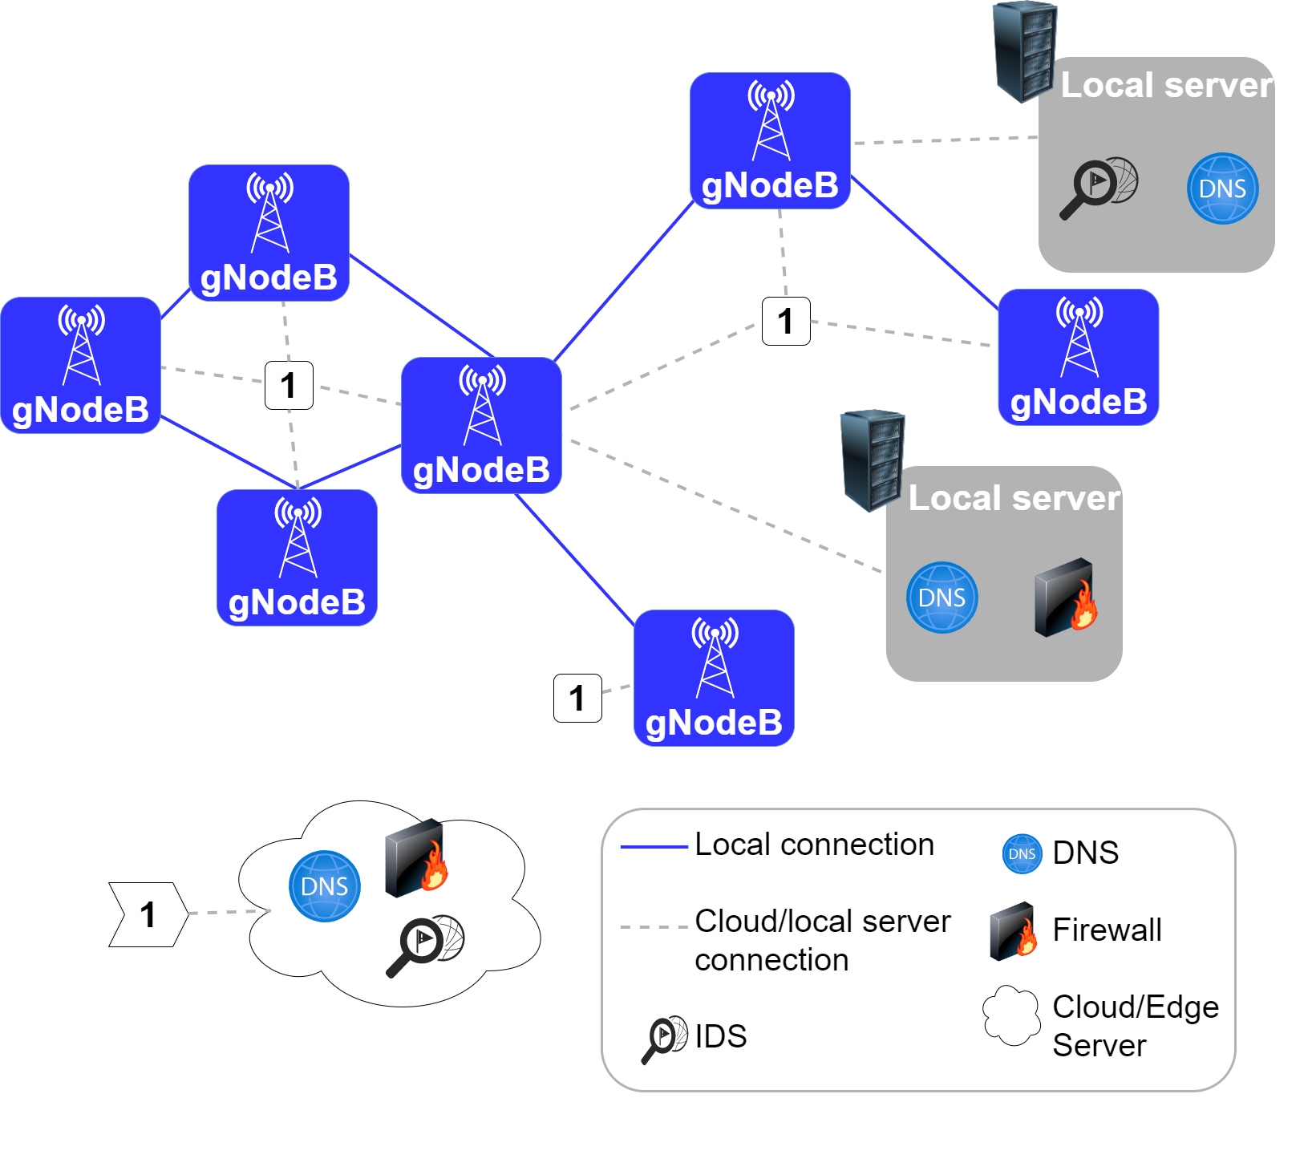
Preliminaries on data Collection for MTP-NT – The predictive model in the 5G Infrastructure
Source: the author
Notes:
Nessa nova infraestrutura, um novo recurso passa a ser valioso: os recursos computacionais
Orquestrador
Encontra o melhor arranjo com base em métricas
Para ajudar o escalonador:
Network Traffic Monitoring and Analysis (NTMA)
VNF
Previsão de tráfego de rede

Slide 45
Main advantages according to European Telecommunications Standards (ETSI)¹
Preliminaries on data Collection for MTP-NT – The predictive model in the 5G Infrastructure
NFV as a service²
Virtualization of Core Network (CN) and Base Stations (BSs)³
Virtualization of home environment⁴
Virtualization of CDNs^{5,6}
[1] ETSI, N. Network Function Virtualisation Use Cases. [S.l.]: European Telecommunications Standards Institute Sophia-Antipolis, France, 2013.
[2] RANKOTHGE, W. et al. Towards making network function virtualization a cloud computing service. In: IEEE. 2015 IFIP/IEEE International Symposium on Integrated Network Management (IM). [S.l.], 2015. p. 89–97.
[3] BASTA, A. et al. Applying nfv and sdn to lte mobile core gateways, the functions placement problem. In: Proceedings of the 4th workshop on All things cellular: operations, applications, & challenges. [S.l.: s.n.], 2014. p. 33–38.
[4] BRONSTEIN, Z.; SHRAGA, E. Nfv virtualisation of the home environment. In: IEEE.
2014 IEEE 11th Consumer Communications and Networking Conference (CCNC). [S.l.], 2014. p. 899–904.
[5] MANGILI, M.; MARTIGNON, F.; CAPONE, A. Stochastic planning for content delivery: Unveiling the benefits of network functions virtualization. In: IEEE. 2014 IEEE 22nd International Conference on Network Protocols. [S.l.], 2014. p. 344–349.
[6] KIM, T.; LEE, B. Scalable cdn service poc over distributed cloud management platform. In: IEEE. 2014 International Conference on Information and Communication Technology Convergence (ICTC). [S.l.], 2014. p. 832–833.
Notes:
Alguns pontos de atenção
- Latêcia geral de uma cadeia de middleboxes

Slide 46
Network Traffic Monitoring and Analysis Also a NFV Problems
Preliminaries on data Collection for MTP-NT – The predictive model in the 5G Infrastructure
Network usage
Orchestrator
NTMA
Problems
Volume
Velocity
Volume
Velocity
Notes:
Nessa nova infraestrutura, um novo recurso passa a ser valioso: os recursos computacionais
Orquestrador
Encontra o melhor arranjo com base em métricas
Network Traffic Monitoring and Analysis (NTMA)
VNF
Previsão de tráfego de rede

Slide 47
How does it flow? How to store? Is there a open standard?
Preliminaries on data Collection for MTP-NT – The predictive model in the 5G Infrastructure
Network usage
Orchestrator
NTMA

Slide 48
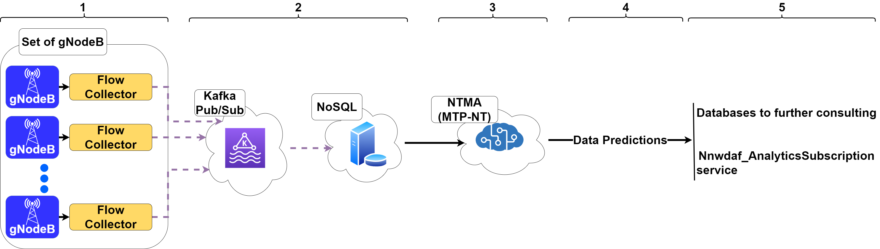
Flow collectors/Network exporters and collectors Radio Access Network (RAN) layer Network Data Analytics Function (NWDAF)¹
Preliminaries on data Collection for MTP-NT – Data flow
[1] 3GPP. Architecture enhancements for 5G System (5GS) to support network data analytics services. [S.l.], 2022. Version 17.5.0. Disponível em: <<https://portal.3gpp. org/desktopmodules/Specifications/SpecificationDetails.aspx?specificationId=3579>>.
Notes:
[18:24]
NWDAF é uma interface padrão do 5G
Pode se comunicar com a camada Policy Control Function (PCF)
PCF: camada de gestão de políticas de fatiamento

Slide 49
NoSQL¹² Less performance penalties with large datasets Popular open source solutions
Preliminaries on data Collection for MTP-NT – Data flow
[1] HAN, J. et al. Survey on nosql database. In: IEEE. 2011 6th international conference on pervasive computing and applications. [S.l.], 2011. p. 363–366.
[2] D’ALCONZO, A. et al. A survey on big data for network traffic monitoring and analysis. IEEE Transactions on Network and Service Management, IEEE, v. 16, n. 3, p. 800–813, 2019.
Notes:
Armazenado para análises futuras

Slide 50
The data is pulled by the MTP-NT, which can be seen as a NTMA
Preliminaries on data Collection for MTP-NT – Data flow
Notes:
Bases para registro das predições
Nnwdaf_AnalyticsSubscription service
- Serviço Publisher-subscriber
- Uso interno no core 5G

Slide 51
Preliminaries on data Collection for MTP-NT – Data flow
Source: the author
Notes:
Alguns pontos de atenção
- Latêcia geral de uma cadeia de middleboxes

Slide 52
Database to Milan and Trento from November 1st to December 31st of 2013¹
Preliminaries on data Collection for MTP-NT – Dataset used in this work
Grid (Telecom Italia)
Social Pulse (Spazio Dati, DEIB)
Telecommunications (Telecom Italia)
Precipitations (Metereotrentino, ARPA)
Weather (ARPA)
Electricity (SET Distribuizione SPA)
News (Citynews)
[1] Barlacchi, G. et al. A multi-source dataset of urban life in the city of milan and the province of trentino. Sci Data 2, 2015.
Notes:
[20:24]
Nem todas as bases de dados foram exploradas
Escolheu-se a cidade de Milão

Slide 53
Telecommunications dataset from Milan
Preliminaries on data Collection for MTP-NT – Dataset used in this work
10,000 zonal regions in a 100x100 regular grid
Each regions is a square of 0.06km²
One log at every 10 minutes in every region
Call Detail Records (CDRs)
Every time an user initiates or ends a network connection;
For a given connection, an additional CDR is generated every 15 additional minutes of connection or if the user transfers more than 5MB over the internet;
Other origins as SMS and calls, but this information is not used in this work.
Notes:
Os grids são regulares apesar da cobertura das torres não ser
Anonimização dos dados que será explorada mais adiante
De acordo com a GDPR: não possibilita rastreamento de um único usuário
Também mantém reservado a capacidade real da infraestrutura da Telecom Italia
Cada parâmetro é multiplicado por uma constante de anonimização

Slide 54
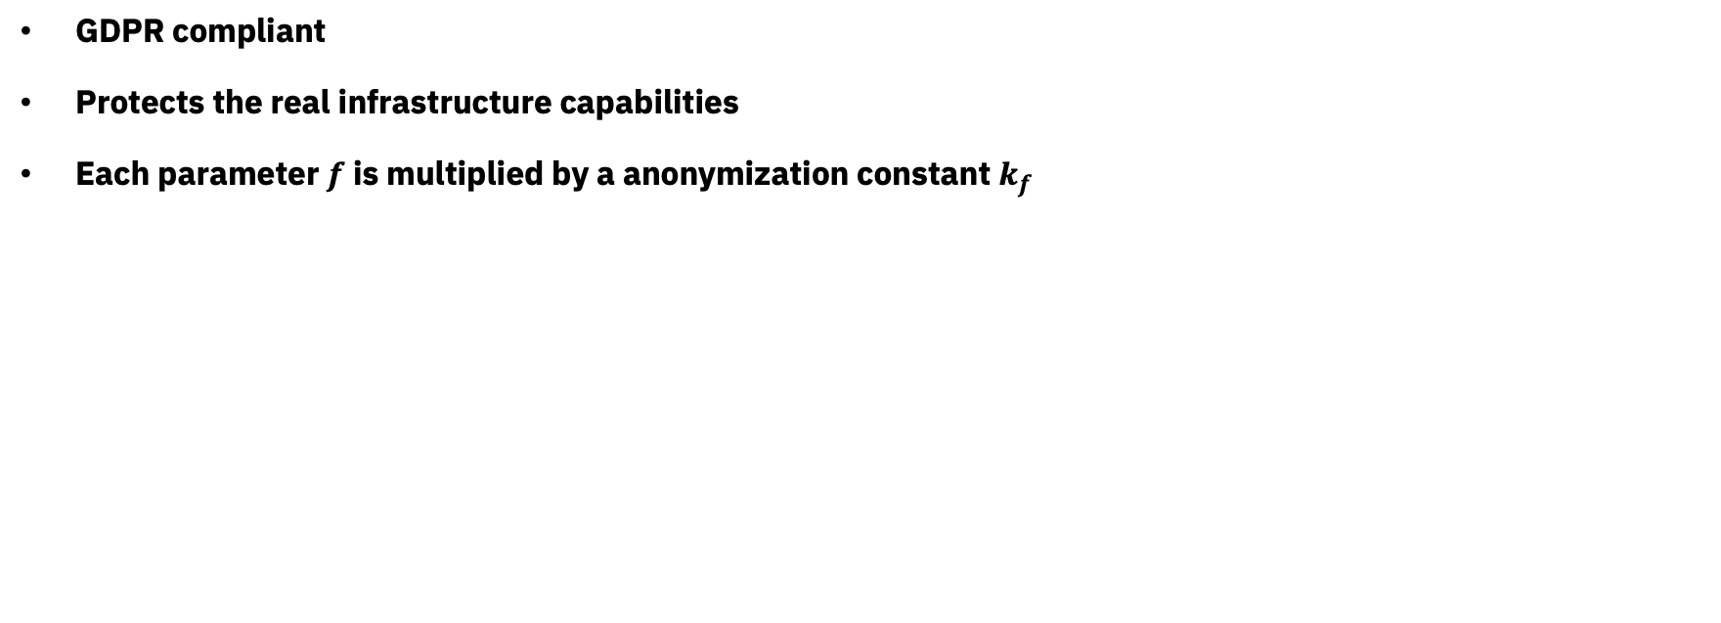
Anonymization of data
Preliminaries on data Collection for MTP-NT – Dataset used in this work
GDPR compliant
Protects the real infrastructure capabilities
Each parameter $f$ is multiplied by a anonymization constant $k_{f}$
Notes:
De acordo com a GDPR: não possibilita rastreamento de um único usuário
Também mantém reservado a capacidade real da infraestrutura da Telecom Italia

Slide 55
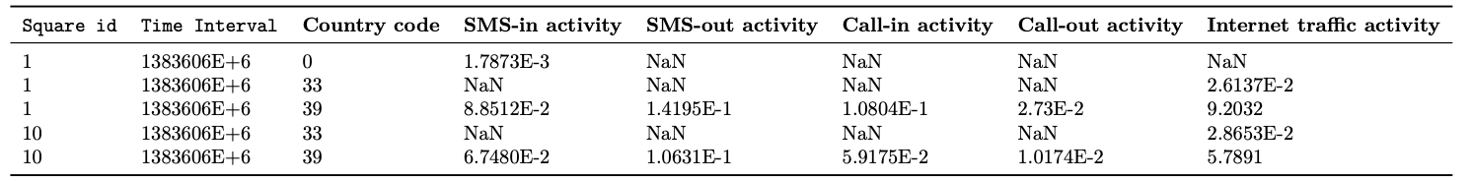
Preliminaries on data Collection for MTP-NT – Dataset used in this work
Notes:
De acordo com a GDPR: não possibilita rastreamento de um único usuário
Também mantém reservado a capacidade real da infraestrutura da Telecom Italia

Slide 56
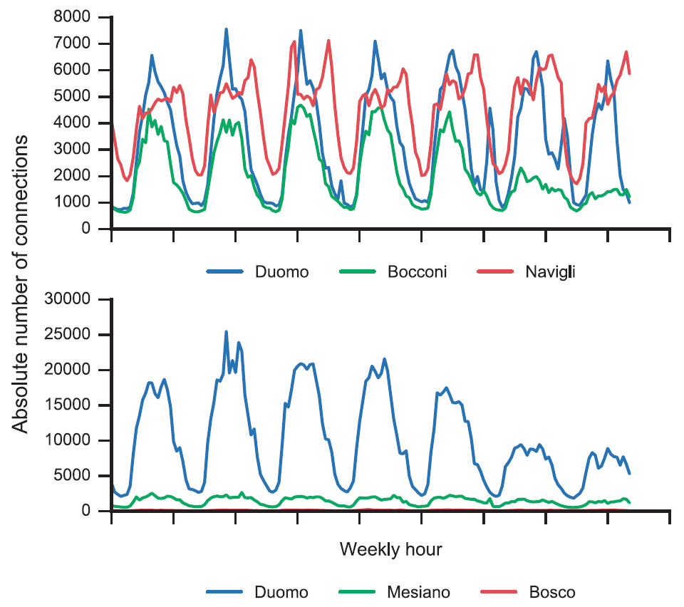
Preliminaries on data Collection for MTP-NT – Dataset used in this work
Source: Barlacchi
Notes:
Gráfico superior
Cada região tem seu padrão de tráfego
Bocconi: universidade; redução do tráfego aos finais de semana
Duomo e Navigli: tráfego mais intenso, majoritariamente de regiões turísticas
Navigli: bairro turístico com grande tráfego no período noturno
Gráfico inferior
- Bosco fica quase imperceptível por ser menos movimentado

Slide 57
Sudden changes in network usage can make predictions inaccurate¹ Despite changes, patterns can be identified and models could be developed² Traffic “hubs” can be a good source of information to traffic prediction^{3,4}
Preliminaries on data Collection for MTP-NT – Dataset used in this work
[1 D’ALCONZO, A. et al . A survey on big data for network traffic monitoring and analysis. IEEE Transactions on Network and Service Management, v. 16, n. 3, p. 800–813, 2019.
[2] PIROZMAND, P. et al. Human mobility in opportunistic networks: Characteristics, models and prediction methods. Journal of Network and Computer Applications, Elsevier, v. 42, p. 45–58, 2014.
[3] WANG, H. et al. Characterizing the spatio-temporal inhomogeneity of mobile traffic in large-scale cellular data networks. In: Proceedings of the 7th International Workshop on Hot Topics in Planet-Scale MObile Computing and Online Social NeTworking. New York, NY, USA: Association for Computing Machinery, 2015. (HOTPOST ’15), p. 19–24. ISBN 9781450335171. Disponível em: <https://doi.org/10.1145/2757513.2757518>.
[4] Wang, X. et al. Spatio-temporal analysis and prediction of cellular traffic in metropolis. In: 2017 IEEE 25th International Conference on Network Protocols (ICNP). [S.l.: s.n.], 2017. p. 1–10.
Notes:
Sudden changes:
Rede pode ter um comportamento irregular
Fundamentalmente, em redes móveis, estamos falando do comportamento humano
Traffic “hubs”:
Pessoas se deslocam em transporte público
Transporte cada vez mais eficiente
Cria correlações entre regiões fisicamente distantes

Slide 58
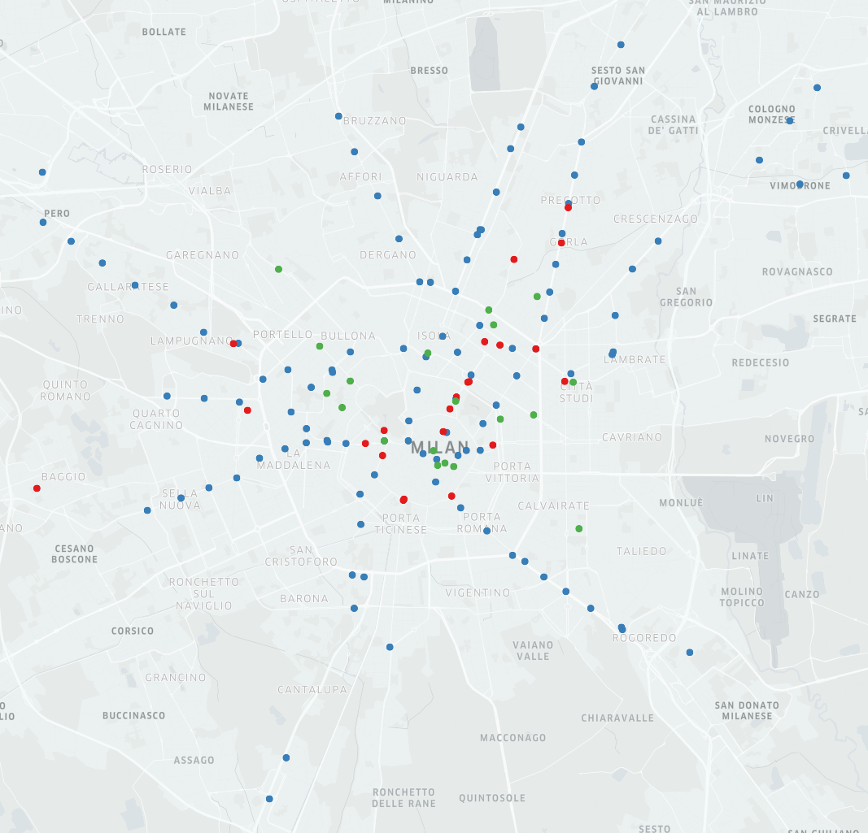
Preliminaries on data Collection for MTP-NT – Dataset used in this work
Source: the author
Notes:
Os dados de transporte público também foram usados conforme será visto mais adiante
Azul: metro
Verde: bonde
Vermelho: ônibus
Dados coletados com a API do Google Maps

Slide 59
Contents
Introduction
Related Work
Theoretical fundamentation
Preliminaries on data collection for MTP-NT
Framework structure and fundamentation
Mathematical formalization of MTP-NT operations
MTP-NT’s framework architecture
Experimental results
Final considerations and future work
Notes:
[23:36]

Slide 60
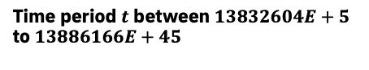
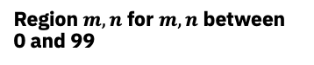
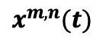
10,000 regions 1 CDR sample for each 10 minutes, from November 1st to December 31st of 2013. Total: 8928 traffic samples for each region
Framework structure and fundamentation – Mathematical formalization of MTP-NT operations
Region $m,n$ for $m,n$ between 0 and 99
$$x^{m,n}(t)$$
Time period $t$ between $13832604E+5$ to $13886166E+45$
Notes:
[24:00]

Slide 61

Moore neighborhood
Framework structure and fundamentation – Mathematical formalization of MTP-NT operations
$$\left|m−m’\right| ≤d, \left|n−n’\right|≤d$$
For a region $x^{m,n}$ the group of neighbors $N$ within a degree $d$ of distance is the group ${N\left(x^{m,n}\right)}_{d}$
$${N\left(x^{m,n}\right)}_{d}=\left\{x^{m,n}|\left|m−m’\right| ≤d, \left|n−n’\right|≤d ∀m, n, m’, n’ ∈\left\{0,1,…,99\right\}\right\}$$

Slide 62
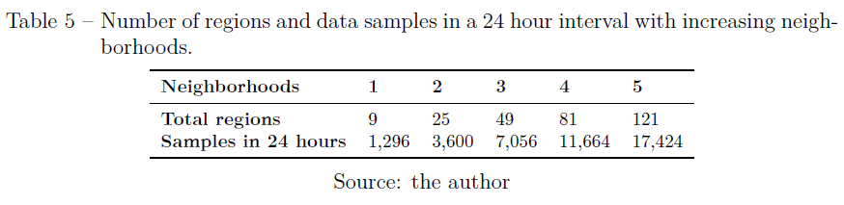
Framework structure and fundamentation – Mathematical formalization of MTP-NT operations
${N\left(x^{m,n}\right)}_{d}$ Scales with the increment of moore neighborhoods

Slide 63
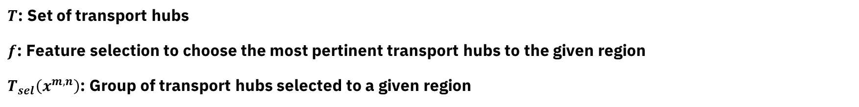
$T$: Set of transport hubs $f$: Feature selection to choose the most pertinent transport hubs to the given region $T_{sel}\left(x^{m,n}\right)$: Group of transport hubs selected to a given region
Framework structure and fundamentation – Mathematical formalization of MTP-NT operations
$$T_{sel}\left(x^{m,n}\right)=\left\{x^{m’,n’}|f_{sel}\left(x^{m,n}\left(t\right),x^{m’,n’}(t)\right)∀x^{m’,n’}∈T\right\}$$

Slide 64
MTP-NT inputs
Framework structure and fundamentation – Mathematical formalization of MTP-NT operations
Time series from the analyzed region Time series from selected neighbors Time series from transport hubs

Slide 65
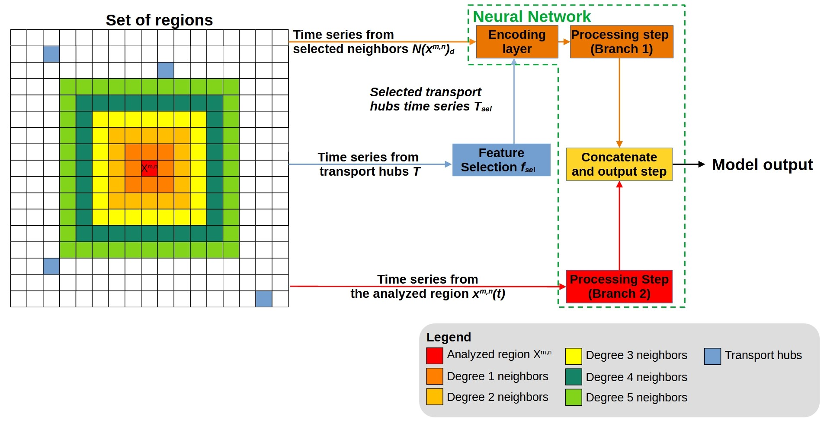
Framework structure and fundamentation – Mathematical formalization of MTP-NT operations
Notes:
Branch 1
Input data from the selected neighbords
Selected time series transport hubs

Slide 66
Framework structure and fundamentation – Mathematical formalization of MTP-NT operations
Notes:
Branch 2
Vizinhos selecionados com base na distância de Moore
Séries temporais dos hubs de transporte selecionados
Algumas técnicas de seleção de variáveis foram testadas
A melhor seleção foi o uso dos 20 hubs mais próximos

Slide 67
Framework structure and fundamentation – Mathematical formalization of MTP-NT operations
Source: the author

Slide 68
Framework structure and fundamentation – Mathematical formalization of MTP-NT operations

Slide 69
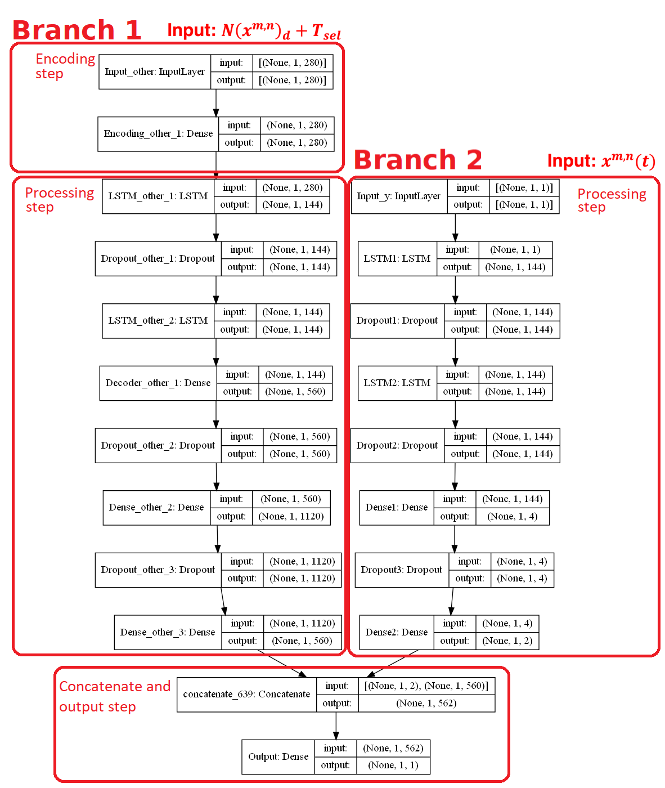
Branch 1
MTP-NT’s framework architecture
Decode the input and begin the compression 𝐼𝑛𝑝𝑢𝑡_𝑜𝑡ℎ𝑒𝑟; 𝐸𝑛𝑐𝑜𝑑𝑖𝑛𝑔_𝑜𝑡ℎ𝑒𝑟_1
Temporal relations 𝐿𝑆𝑇𝑀_𝑜𝑡ℎ𝑒𝑟_1; 𝐷𝑟𝑜𝑝𝑜𝑢𝑡_𝑜𝑡ℎ𝑒𝑟_1
Temporal relations 𝐿𝑆𝑇𝑀_𝑜𝑡ℎ𝑒𝑟_2; 𝐷𝑒𝑐𝑜𝑑𝑒𝑟_𝑜𝑡ℎ𝑒𝑟_1; 𝐷𝑟𝑜𝑝𝑜𝑢𝑡_𝑜𝑡ℎ𝑒𝑟_2
General purpose correlations and reduce overfitting 𝐷𝑒𝑛𝑠𝑒_𝑜𝑡ℎ𝑒𝑟_2; 𝐷𝑟𝑜𝑝𝑜𝑢𝑡_𝑜𝑡ℎ𝑒𝑟_3
Concatenation of Branches 𝐷𝑒𝑛𝑠𝑒_𝑜𝑡ℎ𝑒𝑟_3
Notes:
[26:48]

Slide 70
Branch 2
MTP-NT’s framework architecture
Input layer 𝐼𝑛𝑝𝑢𝑡_y
Temporal relations 𝐿𝑆𝑇𝑀1; 𝐷𝑟𝑜𝑝𝑜𝑢𝑡1 𝐿𝑆𝑇𝑀2;𝐷𝑟𝑜𝑝𝑜𝑢𝑡2
General purpose correlations and reduce overfitting 𝐷𝑒𝑛𝑠𝑒1 𝐷𝑟𝑜𝑝𝑜𝑢𝑡3; 𝐷𝑒𝑛𝑠𝑒2
Concatenation of Branches 𝐷𝑒𝑛𝑠𝑒2
Notes:
Step 2
- 144 units (24 hours of information in 10-minute samples)
- Dropout: randonly deactivate a sample of LSTM cells (10%)
Step 3
- Addition of a dense as a improvement in tests

Slide 71
Concatenate and output step
MTP-NT’s framework architecture
Notes:
Concatenate
Output

Slide 72
MTP-NT’s framework architecture
Source: the author

Slide 73
Contents
Introduction
Related Work
Theoretical fundamentation
Preliminaries on data collection for MTP-NT
MTP-NT: Framework structure and fundamentation
Experimental results
Experimental setup
Results
Execution time evaluation
Performance Analysis
Final considerations and future work
Notes:
[28:24]

Slide 74
Moore regions: 1; 1~2; 1~3; … ; 1~5
Experimental results - Setup

Slide 75
Moore regions: 1; 1~2; 1~3; … ; 1~5
Experimental results - Setup
Feature selection algorithms
F-test
Pearson correlation coeficient
Moore test

Slide 76
Moore regions: 1; 1~2; 1~3; … ; 1~5
Experimental results - Setup
Feature selection algorithms
F-test
Pearson correlation coeficient
Moore test
Tests
Distributed tests
Core tests
Event regions

Slide 77
Moore regions: 1; 1~2; 1~3; … ; 1~5
Experimental results - Setup
Feature selection algorithms
F-test
Pearson correlation coeficient
Moore test
Tests
Distributed tests
Core tests
Event regions
Variations
With transport hubs
Without transport hubs

Slide 78
Moore regions: 1; 1~2; 1~3; … ; 1~5
Experimental results - Setup
Feature selection algorithms
F-test
Pearson correlation coeficient
Moore test
Tests
Distributed tests
Core tests
Event regions
Variations
With transport hubs
Without transport hubs
Plus: dataset compiled in 1-hour samples

Slide 79
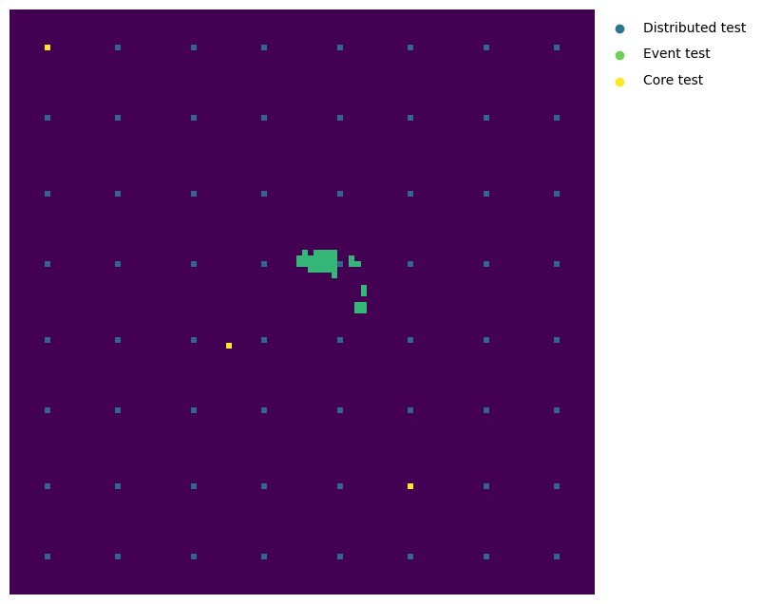
Experimental results - Setup
Source: the author

Slide 80
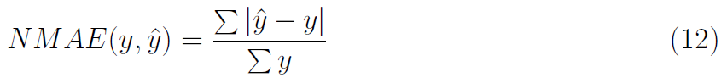
Evaluation metric
Experimental results - Setup

Slide 81
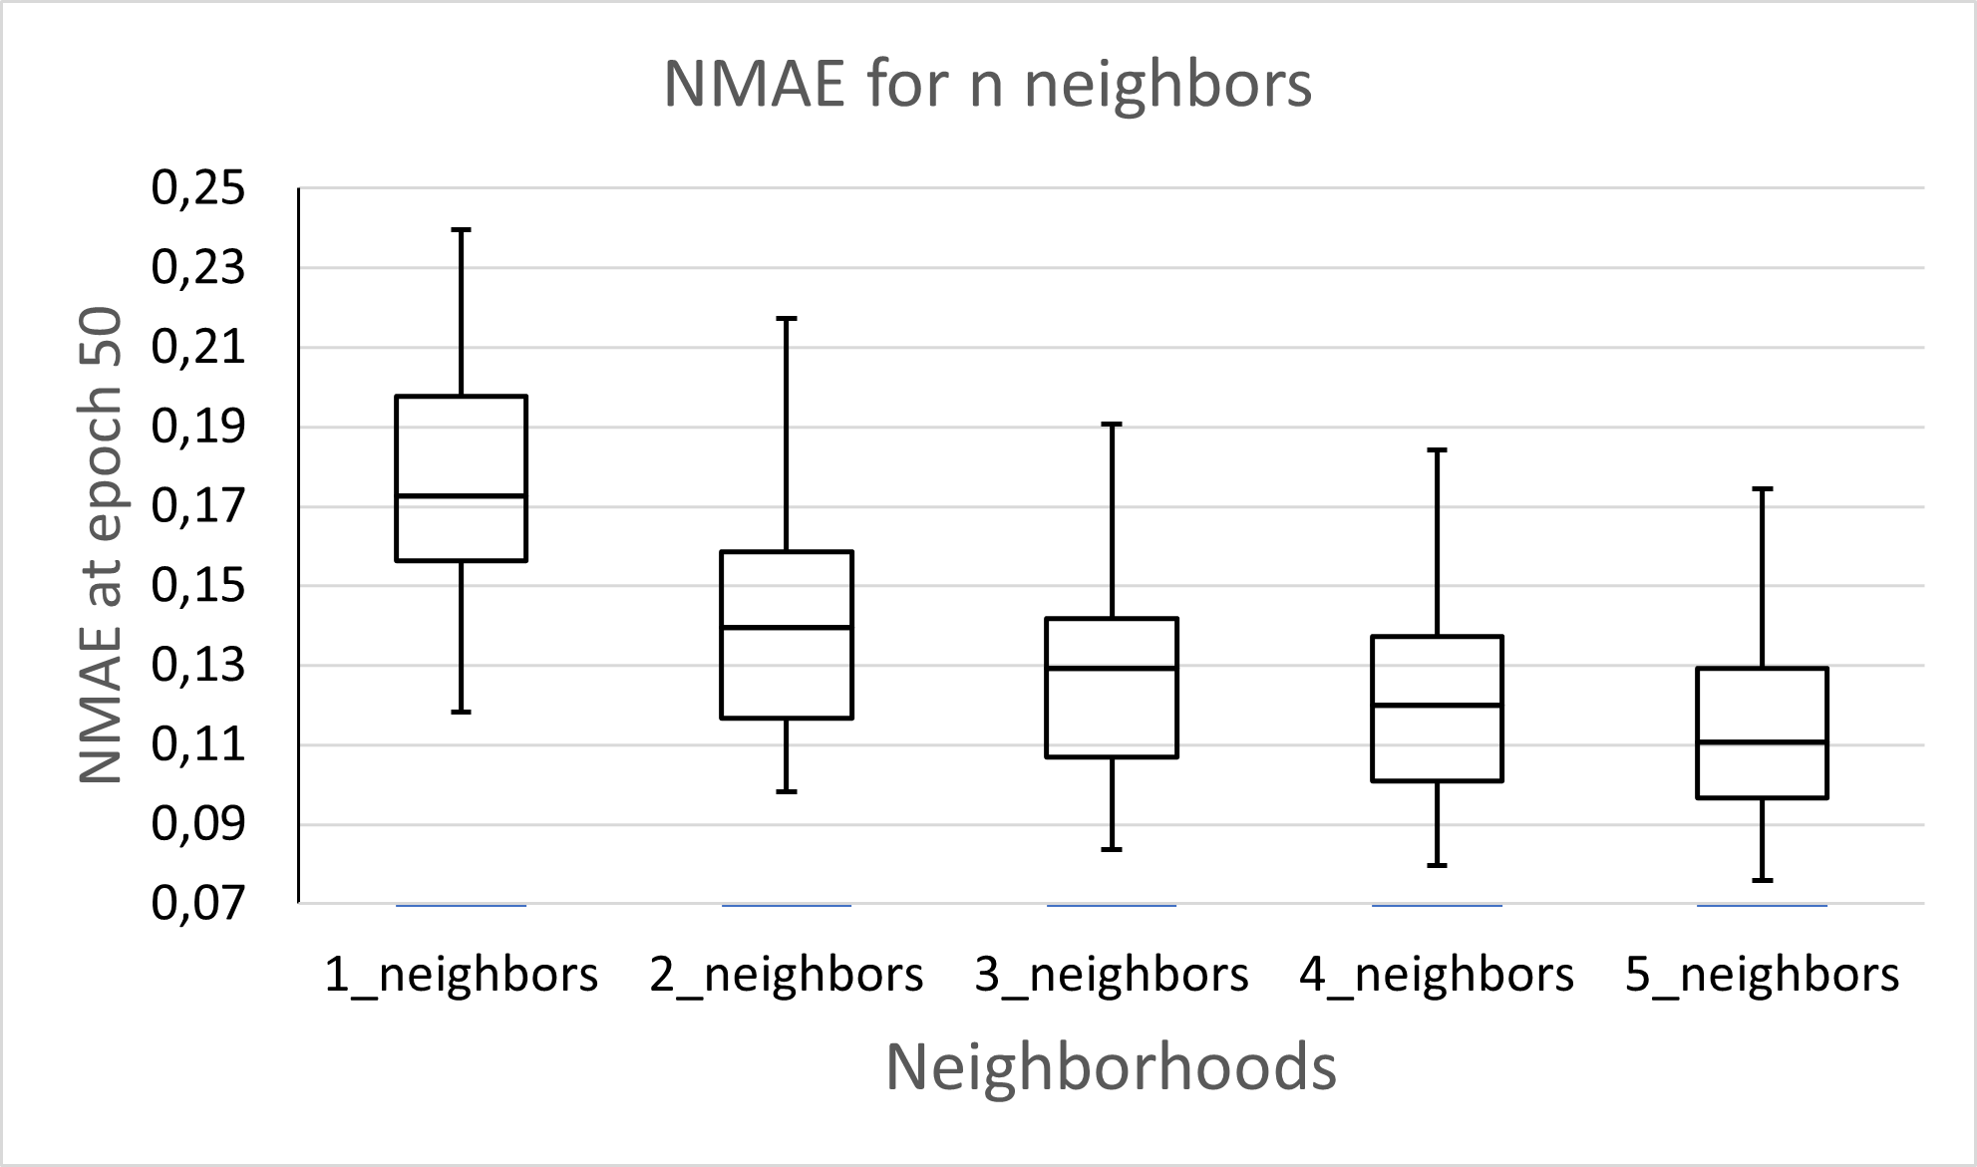
Descendent error
Experimental results - Results
Source: the author
Notes:
[31:12]

Slide 82
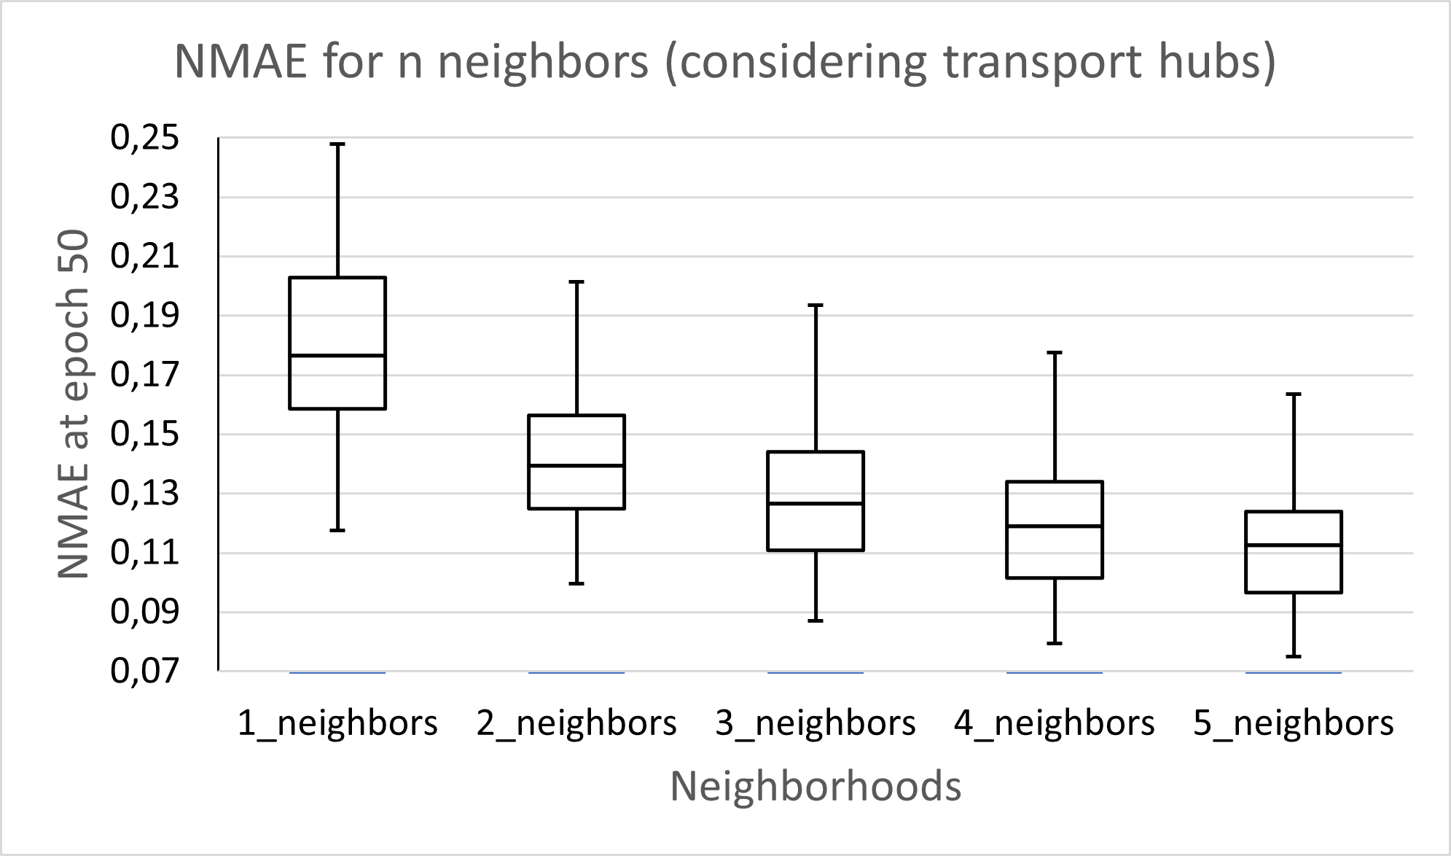
Better overall performance, specially in:
Experimental results - Results
Outliers
Lower Moore distance models
Source: the author

Slide 83
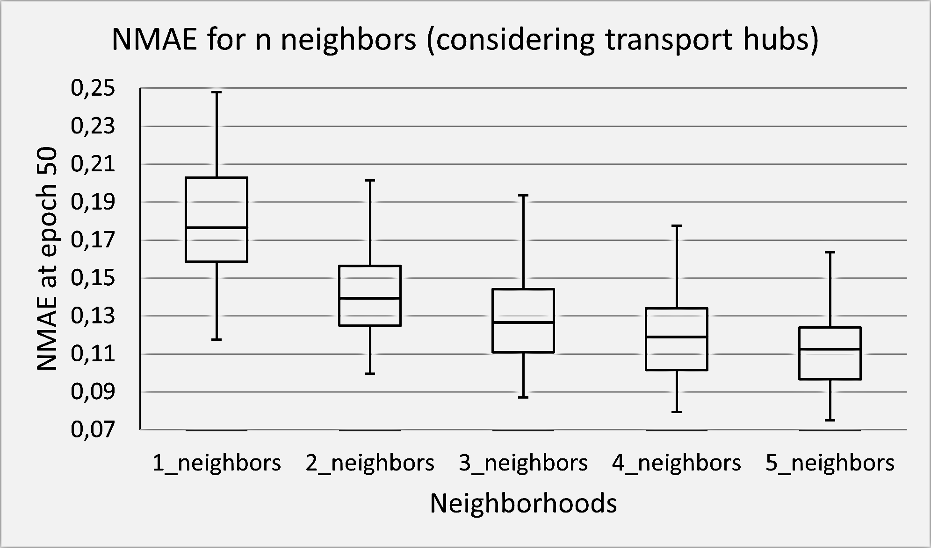
Experimental results - Results
Source: the author

Slide 84
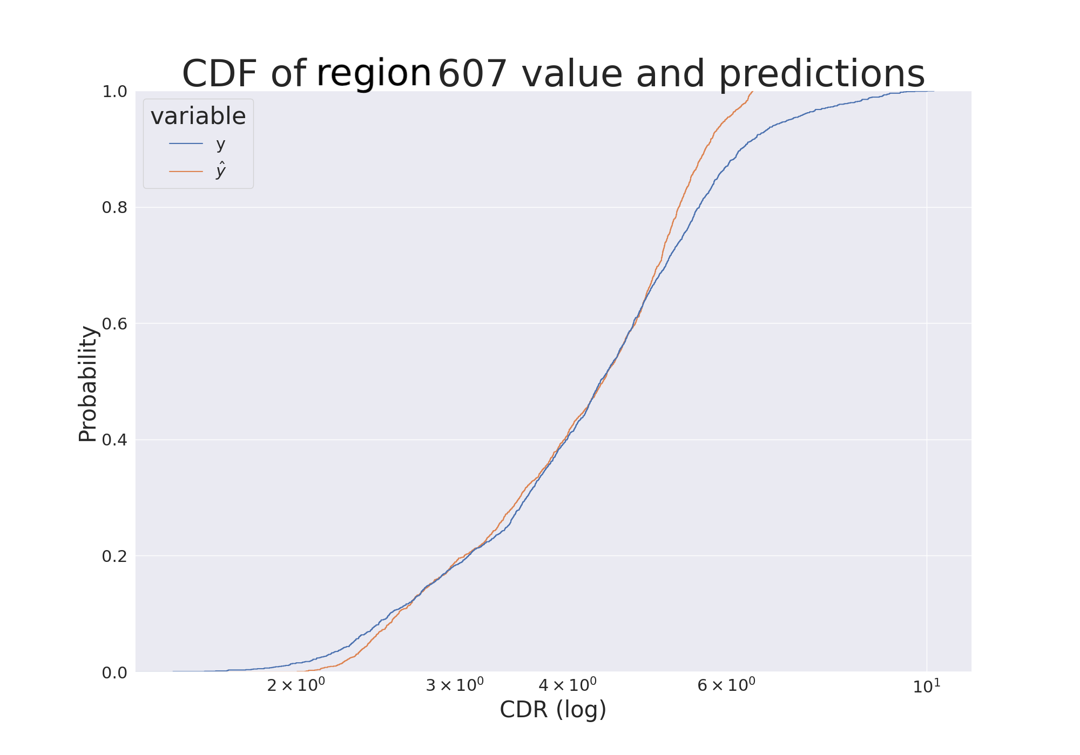
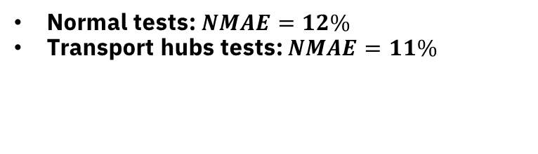
Considerations of transport hubs
Experimental results - Results
Can be important to anticipate fast changing demand from non-seasonal events¹
More important in central regions of the city
Region 607 (near Vigano)
Normal tests: $NMAE=12\%$
Transport hubs tests: $NMAE=11\%$
Source: the author
[1] Wang, J. et al. Spatiotemporal modeling and prediction in cellular networks: A big data enabled deep learning approach. In: IEEE INFOCOM 2017 - IEEE Conference on Computer Communications. [S.l.: s.n.], 2017. p. 1–9.
Notes:
Região periférica
Tráfego de rede mais algo (provavelmente picos anormais) não são cobertos

Slide 85
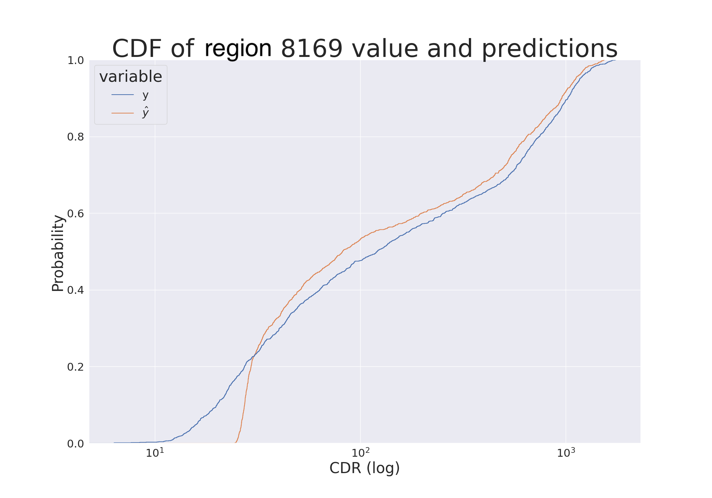
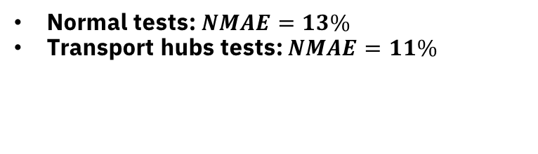
Considerations of transport hubs
Experimental results - Results
Can be important to anticipate fast changing demand from non-seasonal events¹
More important in central regions of the city
Region 8169 (mall near Parco Nord Milano)
Normal tests: $NMAE=13\%$
Transport hubs tests: $NMAE=11\%$
Source: the author
[1] Wang, J. et al. Spatiotemporal modeling and prediction in cellular networks: A big data enabled deep learning approach. In: IEEE INFOCOM 2017 - IEEE Conference on Computer Communications. [S.l.: s.n.], 2017. p. 1–9.
Notes:
Região central
Picos de demanda de tráfego estão sendo cobertos

Slide 86
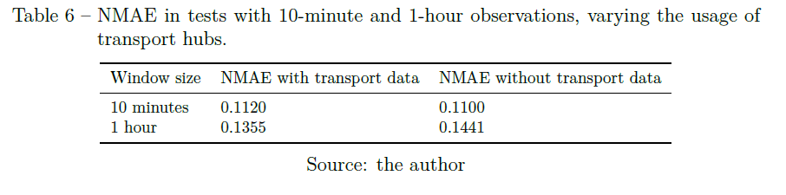
Experimental results - Results
How can MTP-NT perform in a different scenario?
Notes:
Diferentes janelas de tempo podem ser úteis em diferentes cenários
Compilações condizentes com um ajuste menos frequente nas especificações da infra
Base de treinamento ficou 6x menor
Mesmo assim não houve uma perda considerável de performance
Treinamento baixou de 175s~200s para 40s

Slide 87
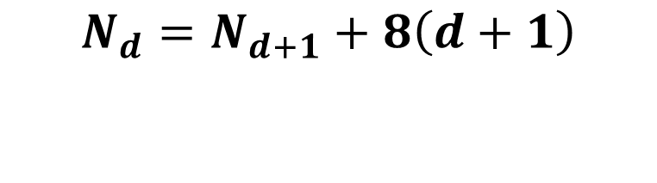
Experimental results – Execution Time Evaluation
Growth of regions with the maximum Moore distance $d$ considered
$$N_{d}=N_{d+1}+8\left(d+1\right)$$
Notes:
[33:36]

Slide 88
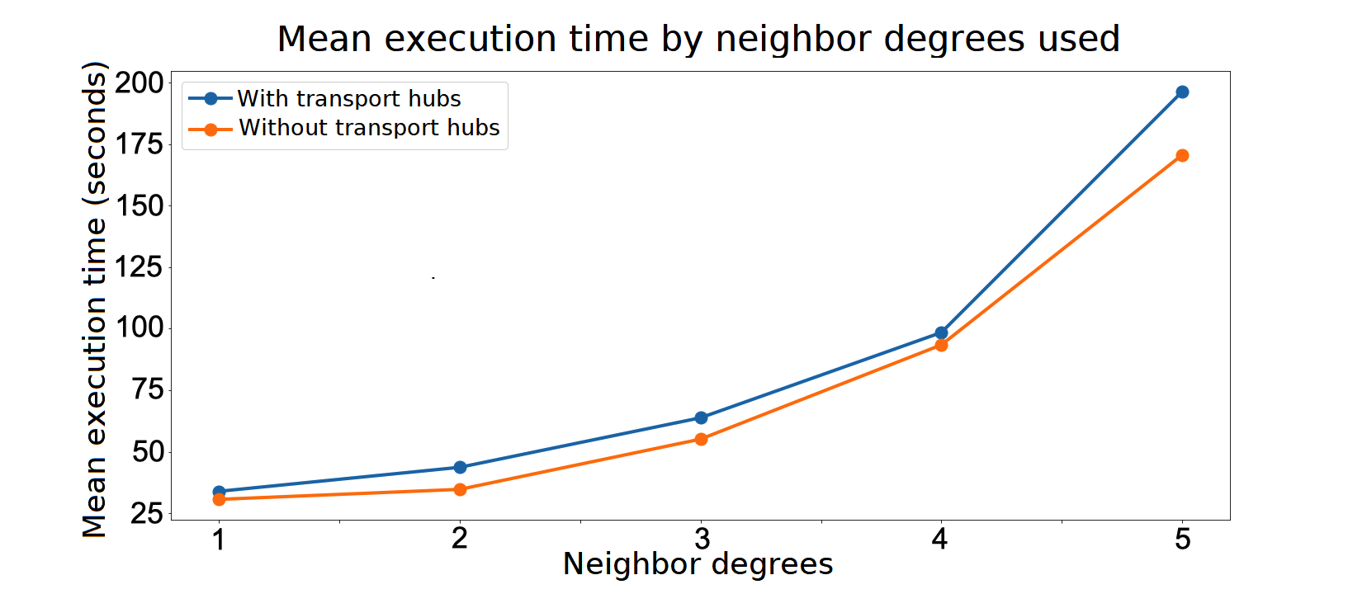
Experimental results – Execution Time Evaluation
Source: the author
Notes:
Adição dos hubs de transporte não implicam diretamente em um tempo de treinamento maior

Slide 89
Experimental results – Performance Analysis
Closed datasets and models – How to compare different studies?
Notes:
[34:24]
Fazendo uma comparação com outras técnicas: ARIMA

Slide 90
Experimental results – Performance Analysis
Closed datasets and models – How to compare different studies?
Answer: Benchmark your proposal against widely known models
ARIMA
HW
Prophet
LSTM model
Notes:
[34:24]
Fazendo uma comparação com outras técnicas: ARIMA

Slide 91
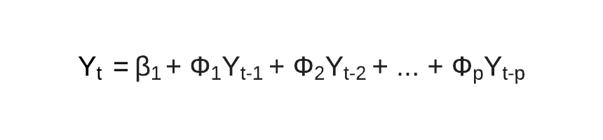
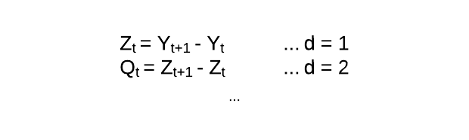
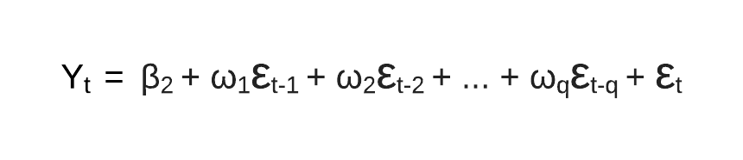
Experimental results – Performance Analysis
Auto Regressive Integrated Moving Average - ARIMA
Autoregression: self correlation (p)
Integration: stationary time series (d)
Moving Average: relation between error of previous samples and the actual (q)
Notes:
[34:24]
Fazendo uma comparação com outras técnicas: ARIMA

Slide 92
Experimental results – Performance Analysis
Auto Regressive Integrated Moving Average – ARIMA
Best model: p=36;d=1;q=0

Slide 93
Experimental results – Performance Analysis
Auto Regressive Integrated Moving Average – ARIMA: p=36;d=1;q=0
Holt-Winters (HW) model: aditive trend
Prophet: daily and weenkly seazonality
LSTM model
Standard scaler
128-cell LSTM layer + Dropout (10%)
128-cell LSTM layer + Dropout (10%)
Dense layer

Slide 94
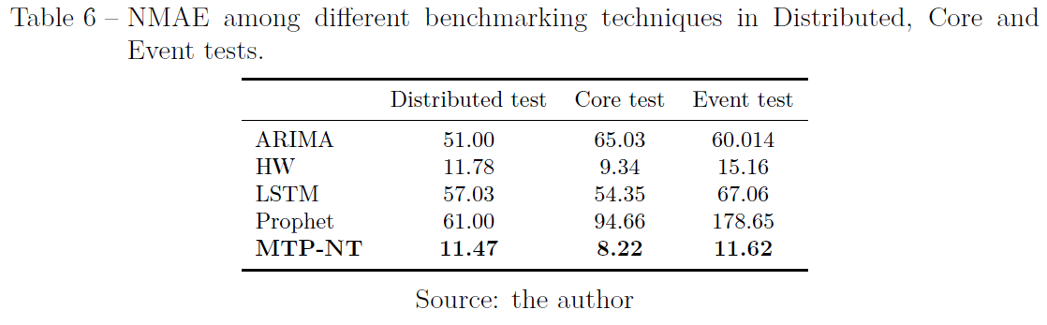
Experimental results – Performance Analysis
Notes:
Bons resultados de forma geral
Testes Core e Event com a mesma performance de forma geral
- Indica que eventos aperiódicos não são um problema para o modelo

Slide 95
Experimental results – Performance Analysis
(Wang 2017b) 45% drop in error compared to LSTM
MTP-NT: 77%
(Wang 2017b) 62% drop in error compared to HW
MTP-NT: similar
Notes:
ARIMA
Tende a fazer previsões em torno das médias passadas
Não indicado para cenários muito dinâmicos

Slide 96
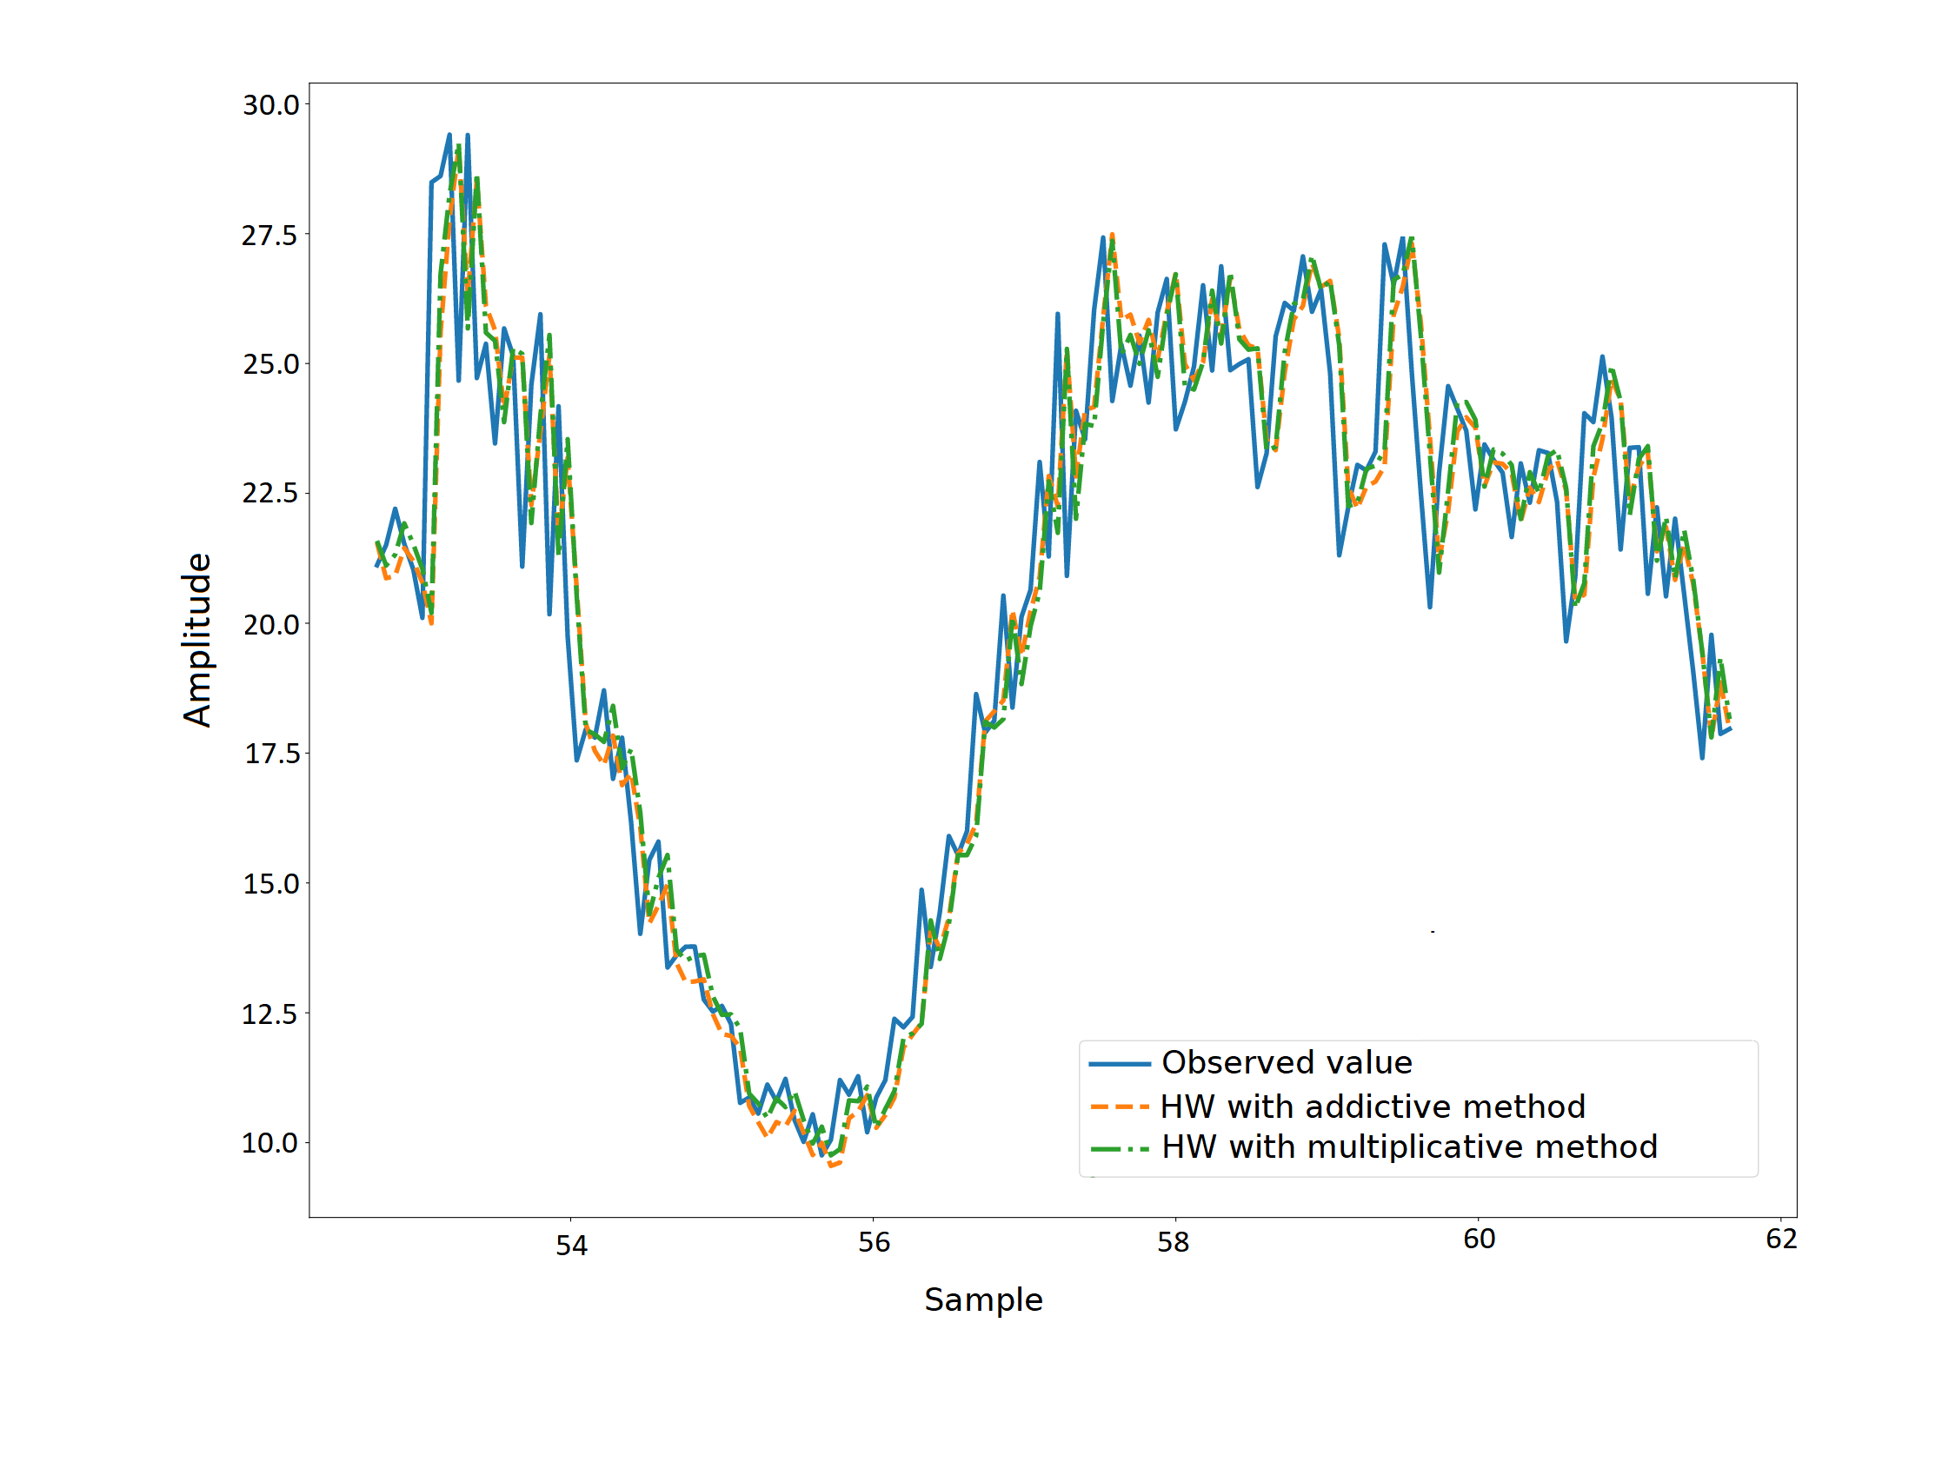
Experimental results – Performance Analysis
Notes:
HW
Basicamente repetindo as amostras anteriores
Boas métricas, mas pouco uso prático

Slide 97
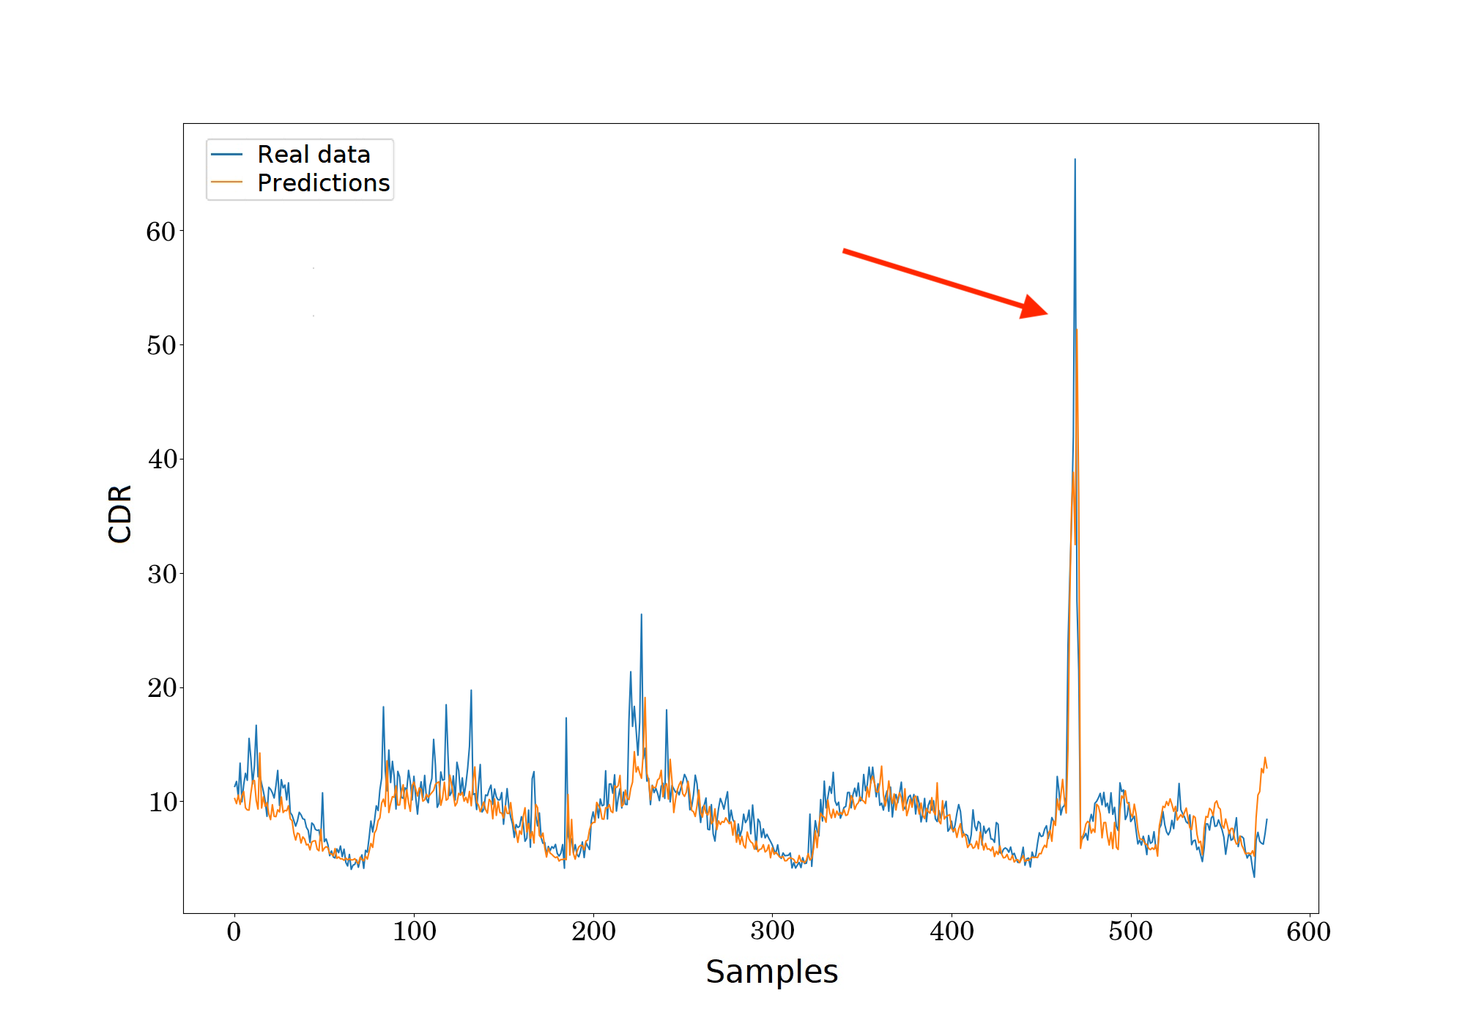
Experimental results – Performance Analysis
Notes:
Teste de evento
Evento aperiódico sendo previsto pelo modelo
NMAE
11% (c/ hubs)
11,59% (sem hubs de transporte)

Slide 98
Contents
Introduction
Related Work
Preliminaries on data collection for MTP-NT
Framework structure and fundamentation
Experimental results
Final considerations and future work
Notes:
[37:12]

Slide 99
Scenario in 5G
Data driven technologies in mobile networks
Notes:
[37:36]

Slide 100
Scenario in 5G
Data driven technologies in mobile networks
Large urban centers
Dynamic scenarios
Patterns and irregular factors
Strict QoS/QoE metrics

Slide 101
Scenario in 5G
Data driven technologies in mobile networks
Large urban centers
Cloud based and compatible with 3GPP architecture purposals
Dynamic scenarios
Patterns and irregular factors
Strict QoS/QoE metrics
Notes:
Virtualização da infraestrutura
Coletores de dados

Slide 102
Scenario in 5G
Data driven technologies in mobile networks
Large urban centers
Cloud based architecture; 3GPP architecture purposal
GDPR and other major privacy policies
Dynamic scenarios
Patterns and irregular factors
Strict QoS/QoE metrics

Slide 103
MTP-NT
Public transport hubs
As a way to bring new information to the model
Improve the coverage of aperiodic events
Notes:
[39:12]

Slide 104
MTP-NT
Public transport hubs
Performance aligned with state of art research
As a way to bring new information to the model
Improve the coverage of aperiodic events

Slide 105
MTP-NT
Public transport hubs
Performance aligned with state of art research
Performance and accuracy tradeoff
As a way to bring new information to the model
Improve the coverage of aperiodic events
The model is flexible and allows a configuration to best fit the accuracy-model size best scenario

Slide 106
MTP-NT
Public transport hubs
Performance aligned with state of art research
Performance and accuracy tradeoff
Multiple tests to ensure the performance
As a way to bring new information to the model
Improve the coverage of aperiodic events
The model is flexible and allows a configuration to best fit the accuracy-model size best scenario
Distributed
Core
Event
1-hour compilling

Slide 107
MTP-NT
Open-source
Public transport hubs
Performance aligned with state of art research
Performance and accuracy tradeoff
Multiple tests to ensure the performance
As a way to bring new information to the model
Improve the coverage of aperiodic events
The model is flexible and allows a configuration to best fit the accuracy-model size best scenario
Distributed
Core
Event
1-hour compilling

Slide 108
Future work
IEEE publication (TNSM)
More neighborhoods
Multi-region model
de Araújo, Patrick Luiz, Pasquini, Rafael, Carneiro, Murillo, Contreras, Luis, "MTP-NT: A Mobile Traffic Predictor Enhanced by Neighboring and Transportation Data," in IEEE Transactions on Network and Service Management,...
Heavier models
GPUs and other advancements make cloud computing cheaper
MTP-NT compiles a single region at a time
A new multi-region architecture can be better
Notes:
[40:00]

Slide 109
Thanks!
A Mobile Traffic Predictor Enhanced by Neighboring Transportation Data (MTP-NT)
Patrick Luiz de Araújo
patrick@ufu.br
Prof. Dr. Rafael Pasquini
rafael.pasquini@ufu.br
Prof. Dr. Murillo Guimarães Carneiro
mgcarneiro@ufu.br

